Slide 1
The CUDA C++ Developer's Toolbox
Notes:
Hello and welcome! My name is Bryce Adelstein Lelbach.
I am a principal engineer at NVIDIA, where I founded the CUDA Core Compute Libraries team and now lead the Vanguard Programming group, which is responsible for programming language design and evolution. My job is to make every major language a GPU language - from Fortran to C++ to Python to Rust to Javascript. I'm involved in the leadership of many programming languages. I chaired the Standard C++ Library Evolution group and the American programming languages standards committee.
Today we're going to explore the tools and best practices that you should use to write idiomatic and modern CUDA C++ code.
But first, what is CUDA C++ and why would we want to use it?

Slide 2
CPU
GPU
Notes:
Modern CPUs and GPUs are both general purpose processors that can run almost any kind of code.
They differ in what types of workloads they are optimized for.

Slide 3
CPU
GPU
100* ns
Mem
100*
GB/s
Numbers are made up and for expository purposes only.
Notes:
CPUs are optimized for latency.
They have more powerful cores and threads, but less of them.
They have less latency to access memory and more memory to access, at the cost of lower throughput.

Slide 4
CPU
GPU
100* ns
500* ns
Mem
Mem
100*
GB/s
1000*
GB/s
Numbers are made up and for expository purposes only.
Notes:
GPUs are optimized for bandwidth and parallelism.
They can run hundreds of thousands of threads.
Their memory latency is higher, but the memory throughput is much greater.

Slide 5
GPU
You need a sufficient workload to benefit from GPUs.
O(N) compute => GBs of data.
More than O(N) compute => less data.
500* ns
Mem
1000*
GB/s
Numbers are made up and for expository purposes only.
Notes:
You need a sufficient workload to benefit from GPUs.
If you try to sum 1000 ints or sort a 100 floats, you're not going to see a speed up from parallelizing that with a GPU.
Your workload is defined by how much compute you're doing per element (the operational intensity), and how many elements you have.
A good rule of thumb is that if you're doing O(N) compute – applying a function to each element or sum them up – then you need gigabytes of data.
If you are doing more than O(N) compute – sorting or matrix multiplication – then you can see speedups with less data.

Slide 6
How do we program a GPU in C++?
Notes:
So how do we program a GPU in C++?

Slide 7
How do we program a GPU in C++?
CUDA C++ and Accelerated Libraries
Notes:
With CUDA C++ and NVIDIA's accelerated libraries!
So what is CUDA C++?

Slide 8
CUDA C++ is an extension of Standard C++ for writing programs that simultaneously run on CPUs (hosts) & GPUs (devices).
CPU
GPU
Host Code
All of
Standard C++
Device Code
Almost all of Standard C++
Notes:
CUDA C++ is an extension of Standard C++ for writing programs that simultaneously run on CPUs (hosts) and GPUs (devices).
In host code, you just write regular C++ - you can use all of Standard C++.
In device code, most but not all of Standard C++ is supported today – for example, you can't throw exceptions yet.
There are some restrictions about how host code and device code can interact – for example, a variable on the stack in device code can't be accessed by host code.

Slide 9





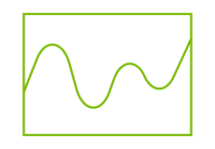

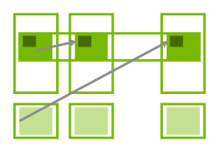
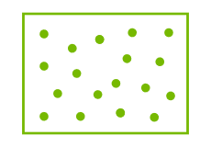


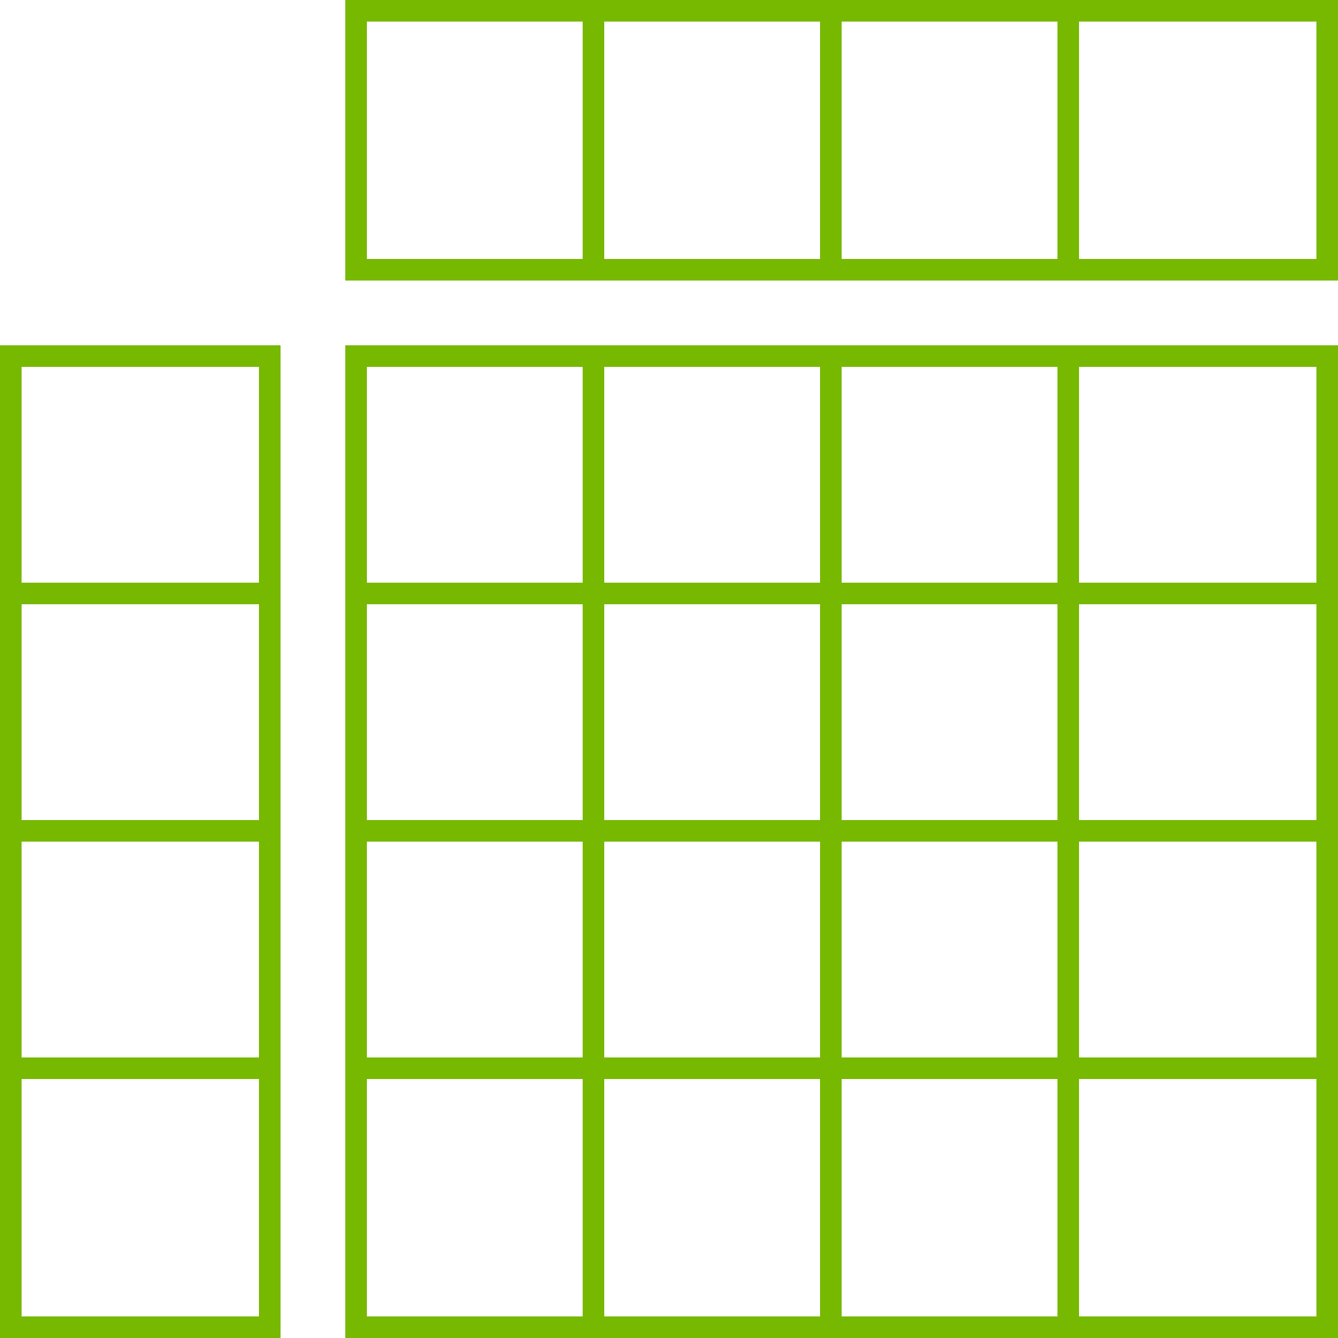
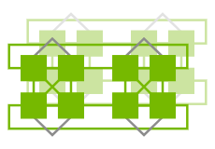

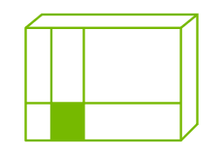
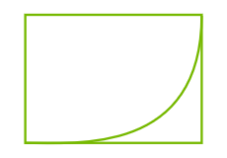


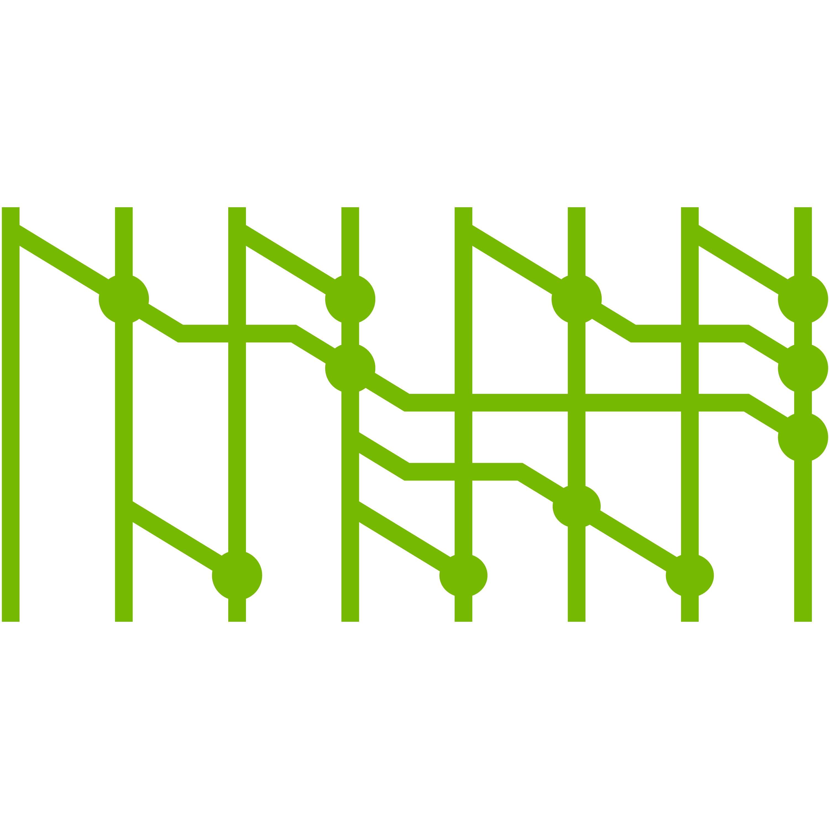
cuBLAS
cuSPARSE
cuFile (GDS)
NVBench
cuFFT
cuDSS
CV CUDA
cuLitho
Cooperative
Groups
NVSHMEM
cuRAND
cuSOLVER
CUDA-Q
CUTLASS
NCCL
cuTENSOR
CUDA Math
CUDA Runtime
Notes:
You don't have to write your CUDA C++ programs from scratch.
There's a diverse collection of CUDA accelerated libraries that you can and should leverage.
These libraries have been carefully designed and tuned to provide speed of light performance. Before you write any CUDA C++ code, you should first check if there's a library that will work for your use case.
If there is, try it out and benchmark it. If it delivers the performance you need, then use it - don't reinvent the wheel.
Now let's dive in with our first CUDA C++ program.

Slide 10
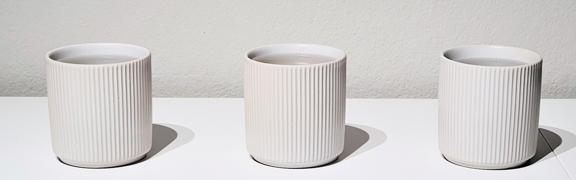

42°C
24°C
50°C
Notes:
Imagine we have a bunch of cups of hot water at different temperatures that are recorded by a thermometer in each cup.
We want to simulate how these cups will cool down.

Slide 11

Ambient Temperature $=$ 20°C
Heat Transfer Coefficient (k) $=$ 0.5
Current
Temperature
42°
24°
50°
Next
Temperature
31°
22°
35°
Next Temp $=$ Current Temp $+$ Heat Transfer Coefficient $∗$ $($Ambient Temp $–$ Current Temp$)$
Notes:
We'll do this by applying Newton's law of cooling for a number of time steps.

Slide 12
int steps = 3;
float k = 0.5;
float ambient_temp = 20;
std::vector<float> cups{42, 24, 50};
Notes:
In Standard C++, we represent our set of cups with a std::vector of floats.

Slide 13
int steps = 3;
float k = 0.5;
float ambient_temp = 20;
std::vector<float> cups{42, 24, 50};
auto op = [=] (float t) {
float diff = ambient_temp - t;
return t + k * diff;
};
Notes:
Next we define our per-cup cooling operator with a C++ lambda.

Slide 14
int steps = 3;
float k = 0.5;
float ambient_temp = 20;
std::vector<float> cups{42, 24, 50};
auto op = [=] (float t) {
float diff = ambient_temp - t;
return t + k * diff;
};
for (int step : std::views::iota(0, steps))
{
…
}
Notes:
Then for each time step…

Slide 15
int steps = 3;
float k = 0.5;
float ambient_temp = 20;
std::vector<float> cups{42, 24, 50};
auto op = [=] (float t) {
float diff = ambient_temp - t;
return t + k * diff;
};
for (int step : std::views::iota(0, steps))
{
std::println("{} {}", step, cups);
std::transform(cups.begin(), cups.end(),
cups.begin(), op);
}
std::transform(first, last,
result, op);
first
result
op( 42 ) 31
op( 24 ) 22
op( 50 ) 35
last
Notes:
…we apply the operator to all of the cups using one of the Standard C++ algorithms, std::transform.

Slide 16


t + k * diff
g++ main.cpp -o a.out
Host code
executable
by CPU
vmla.f32
Notes:
When we compile this Standard C++ code, our compiler lowers each function and operation to the appropriate instruction set for the target processor.

Slide 17
CUDA
C++
t + k * diff
nvcc main.cpp -o a.out
NVCC
Host code
executable
by CPU
vmla.f32
fma.rn.f32
Device code
executable
by GPU
Notes:
But when we're writing a CUDA C++ program, there are two different target processors – the host and the device – and each has its own different instruction set.
The CUDA C++ compiler, NVCC, will compile CUDA C++ code for different targets.

Slide 18
int steps = 3;
float k = 0.5;
float ambient_temp = 20;
std::vector<float> cups{42, 24, 50};
auto op = [=] (float t) {
float diff = ambient_temp - t;
return t + k * diff;
};
for (int step : std::views::iota(0, steps))
{
std::println("{} {}", step, cups);
std::transform(cups.begin(), cups.end(),
cups.begin(), op);
}
Notes:
But how does NVCC know what targets a particular function should be compiled for?

Slide 19
int steps = 3;
float k = 0.5;
float ambient_temp = 20;
std::vector<float> cups{42, 24, 50};
auto op = [=] __host__ __device__ (float t) {
float diff = ambient_temp - t;
return t + k * diff;
};
for (int step : std::views::iota(0, steps))
{
std::println("{} {}", step, cups);
std::transform(cups.begin(), cups.end(),
cups.begin(), op);
}
Notes:
That's what execution space annotations are for.

Slide 20
void a();
__host__
void b();
int steps = 3;
float k = 0.5;
float ambient_temp = 20;
std::vector<float> cups{42, 24, 50};
auto op = [=] __host__ __device__ (float t) {
float diff = ambient_temp - t;
return t + k * diff;
};
for (int step : std::views::iota(0, steps))
{
std::println("{} {}", step, cups);
std::transform(cups.begin(), cups.end(),
cups.begin(), op);
}
Only executable
by the CPU.
Includes all
unannotated
functions.
Notes:
If you don't provide an execution space annotation, the function will only be compiled for host code – meaning the CPU.
You can also explicitly request this with the host annotation.

Slide 21
void a();
__host__
void b();
int steps = 3;
float k = 0.5;
float ambient_temp = 20;
std::vector<float> cups{42, 24, 50};
auto op = [=] __host__ __device__ (float t) {
float diff = ambient_temp - t;
return t + k * diff;
};
for (int step : std::views::iota(0, steps))
{
std::println("{} {}", step, cups);
std::transform(cups.begin(), cups.end(),
cups.begin(), op);
}
Only executable
by the CPU.
Includes all
unannotated
functions.
__device__
void c();
Only executable by the GPU.
Notes:
If a function has only the device annotation, then it will be compiled only for device code (meaning the GPU), and you won't be able to call it from host code.

Slide 22
void a();
__host__
void b();
int steps = 3;
float k = 0.5;
float ambient_temp = 20;
std::vector<float> cups{42, 24, 50};
auto op = [=] __host__ __device__ (float t) {
float diff = ambient_temp - t;
return t + k * diff;
};
for (int step : std::views::iota(0, steps))
{
std::println("{} {}", step, cups);
std::transform(cups.begin(), cups.end(),
cups.begin(), op);
}
Only executable
by the CPU.
Includes all
unannotated
functions.
__device__
void c();
Only executable by the GPU.
__host__
__device__
void d();
Executable by CPU and GPU.
Notes:
If a function has both the host and the device annotation, then it can be used on both the CPU and the GPU.
So now our operator /can/ run on our GPU, but we still need to actually invoke it there.

Slide 23
Execution starts on the host.
CPU
int main()
{
a();
…
}
Notes:
Execution of a CUDA program always begins on the host.

Slide 24
Execution starts on the host.
CPU
int main()
{
a();
launch(gpu, b);
}
GPU
__device__
void b() {
c();
}
Work is explicitly launched on the device.
Notes:
Work must be explicitly launched on the device.

Slide 25
Execution starts on the host.
Transitions between
host and device are explicit.
CPU
int main()
{
a();
launch(gpu, b);
}
GPU
__device__
void b() {
c();
}
Work is explicitly launched on the device.
Notes:
Transitions between host and device are always explicit.
You have to call a function that launches work on the GPU. CUDA C++ won't magically decide to run things on the GPU for you.

Slide 26
Execution starts on the host.
Transitions between
host and device are explicit.
CPU
int main()
{
a();
launch(gpu, b);
}
GPU
__device__
void b() {
c();
}
__device__
void c() {
…
}
Work is explicitly launched on the device.
Functions invoked on the device stay on the device.
Notes:
Functions that are invoked on the device will stay on the device.
You can't launch host functions from the device.

Slide 27
int steps = 3;
float k = 0.5;
float ambient_temp = 20;
std::vector<float> cups{42, 24, 50};
auto op = [=] __host__ __device__ (float t) {
float diff = ambient_temp - t;
return t + k * diff;
};
for (int step : std::views::iota(0, steps))
{
std::println("{} {}", step, cups);
std::transform(cups.begin(), cups.end(),
cups.begin(), op);
}
Notes:
Going back to our example, the work we want to launch on the device is our std::transform.

Slide 28
int steps = 3;
float k = 0.5;
float ambient_temp = 20;
std::vector<float> cups{42, 24, 50};
auto op = [=] __host__ __device__ (float t) {
float diff = ambient_temp - t;
return t + k * diff;
};
for (int step : std::views::iota(0, steps))
{
std::println("{} {}", step, cups);
thrust::transform(thrust::cuda::par, cups.begin(), cups.end(),
cups.begin(), op);
}
Notes:
We can launch this on the device using thrust::transform. It does the same thing as std::transform, but in parallel and on the device.
It takes one additional parameter, an execution policy, which describes the user's requirements for how the algorithm can be parallelized.
In this case, we're asking for the algorithm to be launched in parallel on a CUDA device.

Slide 29
int steps = 3;
float k = 0.5;
float ambient_temp = 20;
thrust::universal_vector<float> cups{42, 24, 50};
auto op = [=] __host__ __device__ (float t) {
float diff = ambient_temp - t;
return t + k * diff;
};
for (int step : std::views::iota(0, steps))
{
std::println("{} {}", step, cups);
thrust::transform(thrust::cuda::par, cups.begin(), cups.end(),
cups.begin(), op);
}
Notes:
We also need to make sure the data is accessible on the device, which we can do by switching from std::vector to thrust::universal_vector.

Slide 30

The C++ Parallel Algorithms Library
https://nvidia.github.io/cccl/thrust
Notes:
Thrust is the C++ parallel algorithms library; its execution-policy algorithms that we just saw were adopted by Standard C++ in 2017.

Slide 31
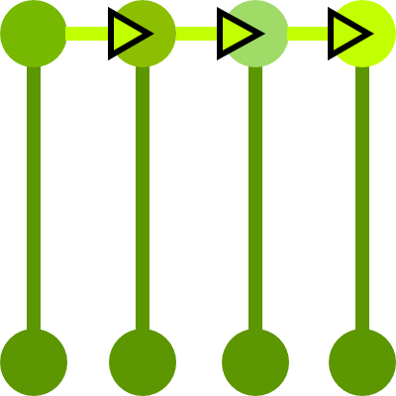
The C++ Parallel Algorithms Library
https://nvidia.github.io/cccl/thrust
Standard Algorithms
thrust::transform_reduce
thrust::inclusive_scan
thrust::sort
thrust::copy
...
Notes:
Thrust has implementations of those standard parallel algorithms…

Slide 32
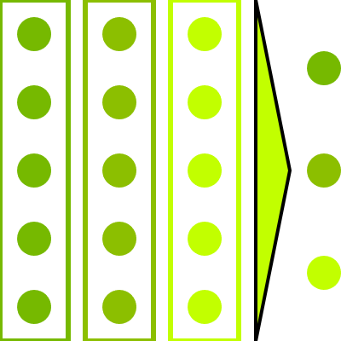
The C++ Parallel Algorithms Library
https://nvidia.github.io/cccl/thrust
Standard Algorithms
thrust::transform_reduce
thrust::inclusive_scan
thrust::sort
thrust::copy
...
Extended Algorithms
thrust::reduce_by_key
thrust::sort_by_key
thrust::tabulate
thrust::gather
...
Notes:
… and also a collection of extensions and additions to the standard algorithms.

Slide 33
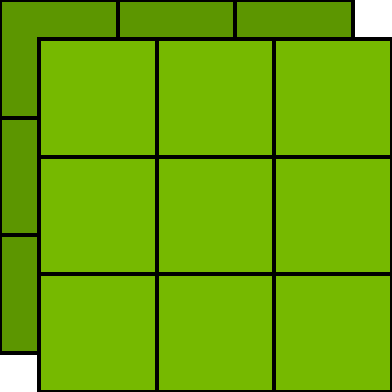
The C++ Parallel Algorithms Library
https://nvidia.github.io/cccl/thrust
Standard Algorithms
thrust::transform_reduce
thrust::inclusive_scan
thrust::sort
thrust::copy
...
Containers
thrust::device_vector
thrust::host_vector
thrust::universal_vector
thrust::allocate_unique
...
Extended Algorithms
thrust::reduce_by_key
thrust::sort_by_key
thrust::tabulate
thrust::gather
...
Notes:
Thrust also has heterogeneous containers that behave like std::vector, but store their contents in different kinds of memory that are accessible to different kinds of processors.

Slide 34
std::vector's contents might only be accessible in host code.
Construction and assignment
is serial.
std::vector<T> h0(1 << 30);
std::vector<T> h1(1 << 30);
h0 = h1;
Notes:
std::vector's contents might only be accessible in host code.
When you construct or assign to a std::vector, that operation is done in serial, which can be quite slow if you're dealing with large amounts of data, as we often do when using GPUs.

Slide 35
std::vector's contents might only be accessible in host code.
Construction and assignment
is serial.
std::vector<T> h0(1 << 30);
std::vector<T> h1(1 << 30);
h0 = h1;
thrust::universal_vector<T> u0(1 << 30);
thrust::universal_vector<T> u1(1 << 30);
u0 = u1;
thrust::universal_vector's contents are accessible in
host and device code.
Construction and assignment
is parallel.
Notes:
thrust::universal_vector's contents are always accessible in both host and device code.
Operations on Thrust vectors like construction and assignment are executed in parallel on the device.

Slide 36
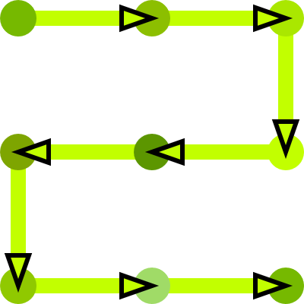
The C++ Parallel Algorithms Library
https://nvidia.github.io/cccl/thrust
Standard Algorithms
thrust::transform_reduce
thrust::inclusive_scan
thrust::sort
thrust::copy
...
Containers
thrust::device_vector
thrust::host_vector
thrust::universal_vector
thrust::allocate_unique
...
Extended Algorithms
thrust::reduce_by_key
thrust::sort_by_key
thrust::tabulate
thrust::gather
...
Iterators
thrust::counting_iterator
thrust::constant_iterator
thrust::transform_iterator
thrust::zip_iterator
...
Notes:
Thrust also has a collection of iterators that can be used in conjunction with Thrust's algorithms to compose more complex computational patterns.

Slide 37
thrust::universal_vector X(N);
thrust::for_each_n(
thrust::cuda::par, X.begin(), N,
[…] __host__ __device__ (auto& obj) { … });
Input
X[0]
X[1]
X[2]
…
Operations
λ
λ
λ
λ
Notes:
Standard C++ and Thrust algorithms typically iterate over sequences of objects – for example, the elements of a container.
However, in numerical and scientific computing, we often want to iterate through indices instead of objects.

Slide 38
auto i = thrust::make_counting_iterator(0);
thrust::for_each_n(
thrust::cuda::par, i, N,
[…] __host__ __device__ (auto idx) { … });
Input
0
1
2
…
Operations
λ
λ
λ
λ
Notes:
We can do this with Thrust counting iterators.
A counting iterator is constructed from an integer and represents the range of all integers from that integer onwards. When dereferenced, it returns that integer. When incremented, it increments the integer.
By passing a counting iterator to a Thrust algorithm like `for_each_n`, we can iterate over indices instead of objects.

Slide 39
auto i = thrust::make_constant_iterator(42);
thrust::for_each_n(
thrust::cuda::par, i, N,
[…] __host__ __device__ (auto idx) { … });
Input
42
42
42
…
Operations
λ
λ
λ
λ
Notes:
Thrust also has a constant iterator, which will repeat the given number forever.
Just like a counting_iterator, it holds an integer, which is returned when it's dereferenced.
But when you increment a constant_iterator, the integer is not changed.

Slide 40
thrust::universal_vector X(N), tmp(N);
thrust::transform(thrust::cuda::par,
X.begin(), X.end(), tmp.begin(), f);
auto r = thrust::reduce(thrust::cuda::par,
tmp.begin(), tmp.end(), T{}, g);
Input
X[0]
X[1]
X[2]
…
f
f
f
f
Operations
g
g
g
Notes:
Iterators can help fuse together operations into beefier and more efficient work.
Suppose we want to transform some data with one function f, and then reduce it with a reduction op g.
There's two problems with this approach as shown.

Slide 41
thrust::universal_vector X(N), tmp(N);
thrust::transform(thrust::cuda::par,
X.begin(), X.end(), tmp.begin(), f);
auto r = thrust::reduce(thrust::cuda::par,
tmp.begin(), tmp.end(), T{}, g);
Input
X[0]
X[1]
X[2]
…
Blocked
f
f
f
f
Operations
Blocked
g
g
g
Notes:
By default, the Thrust algorithms are fork-join synchronous, so each invocation launches its work on the device and then blocks on the host until that work completes.
In our example, this leads to an unnecessary latency bubble which can degrade performance. We wait on the host for the transform to finish before we can start on the reduce, even though there's nothing that we need to do on the host with the result of the transform.

Slide 42
thrust::universal_vector X(N), tmp(N);
thrust::transform(thrust::cuda::par,
X.begin(), X.end(), tmp.begin(), f);
auto r = thrust::reduce(thrust::cuda::par,
tmp.begin(), tmp.end(), T{}, g);
Materializes O(N) temporary storage in precious device memory.
Input
X[0]
X[1]
X[2]
…
Blocked
f
f
f
f
Operations
Blocked
g
g
g
Notes:
Additionally, we've had to allocate O(N) temporary storage for the transformation, which will waste precious device memory and cause expensive and unnecessary loads and stores from device to global memory.

Slide 43
thrust::universal_vector X(N);
auto tmp = thrust::make_transform_iterator(
X.begin(), f);
auto r = thrust::reduce(thrust::cuda::par,
tmp, tmp + N, T{}, g);
Input
X[0]
X[1]
X[2]
…
f
f
f
f
Operations
g
g
g
Notes:
One way to address this problem is to fuse the operations together into a single parallel invocation, which can be done with a transform iterator.
A transform iterator takes some other underlying iterator and a function. When you iterate a transform iterator, you get the result of applying the function to the values from the underlying iterator. This is completely lazy – the function is only evaluated as needed when the elements of the returned iterator are accessed.
For example here, `f` is not evaluated until the elements of `tmp` are accessed in the reduction.

Slide 44
thrust::universal_vector X(N), Y(N);
auto XY = thrust::make_zip_iterator(
thrust::cuda::par, X.begin(), Y.begin());
thrust::for_each_n(
thrust::cuda::par, XY, N, f);
X[0]
X[1]
…
Input
Y[0]
Y[1]
…
f(tuple{X[0], Y[0]})
Operations
f(tuple{X[1], Y[1]})
f(tuple{X[…], Y[…]})
Notes:
Sometimes we need to combine multiple inputs into a single iterator to pass to an algorithm.
This can be done with a zip iterator, which takes any number of other iterators and produces tuples that are a combination of the values from the underlying iterators at the corresponding position.
Suppose we make a zip iterator from X and Y here. When you dereference this iterator the first time, you'll get a two-element tuple X[0] and Y[0]; if we increment it and dereference again, we'll get X[1] and Y[1].

Slide 45
thrust::universal_vector X(N);
auto adj = thrust::make_zip_iterator(
thrust::cuda::par, X.begin(), X.begin() + 1);
thrust::for_each_n(
thrust::cuda::par, adj, N - 1, f);
X[0]
X[1]
…
Input
X[1]
X[2]
…
f(tuple{X[0], X[1]})
Operations
f(tuple{X[1], X[2]})
f(tuple{X[…], X[…]})
Notes:
You can also use zip iterators to invoke algorithms on overlapping windows or stencils of elements.
Here we're constructing a zip iterator to the adjacent pairs of elements of `X` and then applying the function `f` to each pair with `for_each_n`.
So `f` will be invoked with `X[0]` and `X[1]`, and then it will be invoked with `X[1]` and `X[2]` etc until the end of the iterator.

Slide 46
5
2
9
7
A
1
9
6
8
B
5
2
9
7
A
-
-
-
-
-
1
9
6
8
B
4
-7
3
-1
max(abs)
7
Notes:
Let's look at another example that combines all of this together.
Suppose we have two vectors of the same length, A and B. We want to calculate the maximum difference between corresponding elements of each vector.
We can do this by first calculating the difference between each two elements, and then doing a max reduction of the absolute value of the differences.

Slide 47
5
2
9
7
thrust::universal_vector<int> A(…);
thrust::universal_vector<int> B(…);
1
9
6
8
Notes:
We start off with our two `universal_vector`s, A and B.

Slide 48
5
2
9
7
thrust::universal_vector<int> A(…);
thrust::universal_vector<int> B(…);
thrust::universal_vector<int> diffs(A.size());
thrust::transform(thrust::cuda::par,
A.begin(), A.end(), B.begin(), diffs.begin(),
[] __host__ __device__ (int a, int b)
{ return abs(a - b); });
1
9
6
8
-
-
-
-
5
1
2
9
9
6
7
8
Notes:
Then we calculate the differences between each two elements of A and B, storing it in a temporary vector that we've allocated.

Slide 49
5
2
9
7
thrust::universal_vector<int> A(…);
thrust::universal_vector<int> B(…);
thrust::universal_vector<int> diffs(A.size());
thrust::transform(thrust::cuda::par,
A.begin(), A.end(), B.begin(), diffs.begin(),
[] __host__ __device__ (int a, int b)
{ return abs(a - b); });
auto max_diff = thrust::reduce(
thrust::cuda::par,
diffs.begin(), diffs.end(),
0,
cuda::maximum{});
1
9
6
8
-
-
-
-
5
1
2
9
9
6
7
8
Notes:
And finally we do a reduction of the differences, with maximum as the reduction operator.

Slide 50
5
2
9
7
thrust::universal_vector<int> A(…);
thrust::universal_vector<int> B(…);
auto AB = thrust::make_zip_iterator(
A.begin(), B.begin());
auto diffs = thrust::make_transform_iterator(
AB.begin(),
[] __host__ __device__
(cuda::std::tuple<int, int> ab) {
auto [a, b] = ab;
return abs(a - b)
});
auto max_diff = thrust::reduce(
thrust::cuda::par,
diffs, diffs + A.size(),
0,
cuda::maximum{});
1
9
6
8
{ }
{ }
{ }
{ }
5
1
2
9
9
6
7
8
-
-
-
-
Notes:
We can improve this by replacing the transform with a zip iterator and a transform iterator.

Slide 51
5
2
9
7
thrust::universal_vector<int> A(…);
thrust::universal_vector<int> B(…);
auto AB = thrust::make_zip_iterator(
A.begin(), B.begin());
auto diffs = thrust::make_transform_iterator(
AB.begin(),
[] __host__ __device__
(cuda::std::tuple<int, int> ab) {
auto [a, b] = ab;
return abs(a - b)
});
auto max_diff = thrust::reduce(
thrust::cuda::par,
diffs, diffs + A.size(),
0,
cuda::maximum{});
1
9
6
8
{ }
{ }
{ }
{ }
5
1
2
9
9
6
7
8
-
-
-
-
Notes:
The zip iterator produces two element tuples of each corresponding element of A and B.

Slide 52
5
2
9
7
thrust::universal_vector<int> A(…);
thrust::universal_vector<int> B(…);
auto AB = thrust::make_zip_iterator(
A.begin(), B.begin());
auto diffs = thrust::make_transform_iterator(
AB.begin(),
[] __host__ __device__
(cuda::std::tuple<int, int> ab) {
auto [a, b] = ab;
return abs(a - b)
});
auto max_diff = thrust::reduce(
thrust::cuda::par,
diffs, diffs + A.size(),
0,
cuda::maximum{});
1
9
6
8
{ }
{ }
{ }
{ }
5
1
2
9
9
6
7
8
-
-
-
-
Notes:
And the transform iterator takes that zip iterator and applies a lambda function to it that unpacks the tuple and computes the difference between the two values.

Slide 53
5
2
9
7
thrust::universal_vector<int> A(…);
thrust::universal_vector<int> B(…);
auto AB = thrust::make_zip_iterator(
A.begin(), B.begin());
auto max_diff = thrust::transform_reduce(
thrust::cuda::par,
AB, AB + A.size(),
[] __host__ __device__
(cuda::std::tuple<int, int> ab) {
auto [a, b] = ab;
return abs(a - b)
},
0,
cuda::maximum{});
1
9
6
8
{ }
{ }
{ }
{ }
5
1
2
9
9
6
7
8
-
-
-
-
Notes:
This pattern of transforming and then reducing is quite common and very powerful, so Thrust has a single algorithm called `transform_reduce` that does the fusion with the transform iterator for you. It's equivalent to the code on the slide before.
This known as map reduce in some domains.

Slide 54
5
2
9
7
thrust::universal_vector<int> A(…);
thrust::universal_vector<int> B(…);
auto AB = thrust::make_zip_iterator(
A.begin(), B.begin());
auto max_diff = thrust::transform_reduce(
thrust::cuda::par,
AB, AB + A.size(),
[] __host__ __device__
(cuda::std::tuple<int, int> ab) {
auto [a, b] = ab;
return abs(a - b)
},
0,
cuda::maximum{});
1
9
6
8
{ }
{ }
{ }
{ }
5
1
2
9
9
6
7
8
-
-
-
-
Notes:
We used two new facilities in this example – cuda::std::tuple instead of std::tuple, and cuda::maximum instead of std::max.

Slide 55

The CUDA C++ Foundational Library
https://nvidia.github.io/cccl/libcudacxx
Learn More: S72575 How You Should Write a CUDA C++ Kernel
Notes:
These are facilities from libcu++, CUDA's C++ foundational and standard library.

Slide 56
The CUDA C++ Foundational Library
https://nvidia.github.io/cccl/libcudacxx
Learn More: S72575 How You Should Write a CUDA C++ Kernel
Host Compiler’s Standard Library (GCC, LLVM, MSVC, etc)
#include <…> Standard C++, __host__ only.
std:: Complete, strictly conforming to Standard C++.
Notes:
CUDA C++ uses your host platform's C++ compiler and C++ Standard Library for host code – so GCC, Clang, MSVC, etc.
The facilities in the std namespace come from the host C++ Standard Library and are host only.

Slide 57
The CUDA C++ Foundational Library
https://nvidia.github.io/cccl/libcudacxx
Learn More: S72575 How You Should Write a CUDA C++ Kernel
Host Compiler’s Standard Library (GCC, LLVM, MSVC, etc)
#include <…> Standard C++, __host__ only.
std:: Complete, strictly conforming to Standard C++.
#include <cuda/std/…> CUDA C++, __host__ __device__.
cuda::std:: Subset, strictly conforming to Standard C++.
libcu++
Notes:
libcu++ provides a subset of the C++ Standard Library in the cuda::std namespace.
These facilities can be used in and across host and device code.

Slide 58
The CUDA C++ Foundational Library
https://nvidia.github.io/cccl/libcudacxx
Learn More: S72575 How You Should Write a CUDA C++ Kernel
Host Compiler’s Standard Library (GCC, LLVM, MSVC, etc)
#include <…> Standard C++, __host__ only.
std:: Complete, strictly conforming to Standard C++.
#include <cuda/std/…> CUDA C++, __host__ __device__.
cuda::std:: Subset, strictly conforming to Standard C++.
#include <cuda/…> CUDA C++, __host__ and/or __device__.
cuda:: Modern C++ API for CUDA & Standard C++ extensions.
libcu++
Notes:
libcu++ also has many extensions to the C++ Standard Library, as well as modern C++ APIs for the CUDA runtime and device-side facilities.
You can find these in the cuda namespace.

Slide 59
The CUDA C++ Foundational Library
https://nvidia.github.io/cccl/libcudacxx
Learn More: S72575 How You Should Write a CUDA C++ Kernel
Host Compiler’s Standard Library (GCC, LLVM, MSVC, etc)
#include <…> Standard C++, __host__ only.
std:: Complete, strictly conforming to Standard C++.
#include <cuda/std/…> CUDA C++, __host__ __device__.
cuda::std:: Subset, strictly conforming to Standard C++.
#include <cuda/…> CUDA C++, __host__ and/or __device__.
cuda:: Modern C++ API for CUDA & Standard C++ extensions.
#include <cuda/experimental/…> CUDA C++, __host__ and/or __device__.
cuda::experimental:: (cudax::) Beta features.
libcu++
Notes:
Beta features that are not yet stable are in the cuda::experimental or cudax namespace.

Slide 60
The C++ Parallel Algorithms Library
https://nvidia.github.io/cccl/thrust
Standard Algorithms
thrust::transform_reduce
thrust::inclusive_scan
thrust::sort
thrust::copy
...
Containers
thrust::device_vector
thrust::host_vector
thrust::universal_vector
thrust::allocate_unique
...
Extended Algorithms
thrust::reduce_by_key
thrust::sort_by_key
thrust::tabulate
thrust::gather
...
Iterators
thrust::counting_iterator
thrust::constant_iterator
thrust::transform_iterator
thrust::zip_iterator
...
Notes:
Now let's take a look at one of the most popular kinds of extended algorithms in Thrust – by key algorithms.
By key algorithms will divide the input up into contiguous groups and invoke an underlying algorithm on each group.

Slide 61
ny
int nx(…), ny(…);
thrust::universal_vector<float> M(nx * ny);
15
6
18
15
54
29
26
24
10
89
1
4
12
8
25
8
15
1
14
38
nx
26
5
12
25
68
13
14
23
25
75
20
23
19
18
80
11
14
3
12
40
Notes:
For example, suppose we have a matrix, and we want to sum each row.
To use a by-key algorithm to solve this problem, we must first create a range of keys that define the groups.

Slide 62
ny
int nx(…), ny(…);
thrust::universal_vector<float> M(nx * ny);
15
6
18
15
54
29
26
24
10
89
1
4
12
8
25
8
15
1
14
38
nx
26
5
12
25
68
Each set of consecutive keys that compare equal defines a group.
13
14
23
25
75
20
23
19
18
80
11
14
3
12
40
Notes:
Each set of consecutive keys that compare equal defines a group.

Slide 63
ny
int nx(…), ny(…);
thrust::universal_vector<float> M(nx * ny);
0
0
0
0
1
1
1
1
2
2
2
2
3
3
3
3
nx
4
4
4
4
Each set of consecutive keys that compare equal defines a group.
5
5
5
5
6
6
6
6
7
7
7
7
Notes:
In our example, all elements in the same row should have the same key.
The value of that key can be its row index.

Slide 64
ny
int nx(…), ny(…);
thrust::universal_vector<float> M(nx * ny);
auto row_ids_begin =
thrust::make_transform_iterator(
thrust::make_counting_iterator(0),
[=] __host__ __device__ (int x) {
return x / ny;
});
auto row_ids_end = row_ids_begin + nx * ny;
0
0
0
0
1
1
1
1
2
2
2
2
3
3
3
3
nx
4
4
4
4
Each set of consecutive keys that compare equal defines a group.
5
5
5
5
6
6
6
6
7
7
7
7
Notes:
We don't have to materialize these keys in memory – we can generate them with Thrust lazy iterators.
We use a counting iterator to generate the linearized location of each element, then we determine its row by dividing by the number of columns using a transform iterator.

Slide 65
ny
int nx(…), ny(…);
thrust::universal_vector<float> M(nx * ny);
auto row_ids_begin =
thrust::make_transform_iterator(
thrust::make_counting_iterator(0),
[=] __host__ __device__ (int x) {
return x / ny;
});
auto row_ids_end = row_ids_begin + nx * ny;
thrust::universal_vector<float> sums(nx);
15
6
18
15
29
26
24
10
1
4
12
8
8
15
1
14
nx
26
5
12
25
13
14
23
25
20
23
19
18
11
14
3
12
Notes:
Next, we'll need some storage for the sums for each row.

Slide 66
ny
int nx(…), ny(…);
thrust::universal_vector<float> M(nx * ny);
auto row_ids_begin =
thrust::make_transform_iterator(
thrust::make_counting_iterator(0),
[=] __host__ __device__ (int x) {
return x / ny;
});
auto row_ids_end = row_ids_begin + nx * ny;
thrust::universal_vector<float> sums(nx);
thrust::reduce_by_key(thrust::cuda::par,
…);
15
6
18
15
29
26
24
10
1
4
12
8
8
15
1
14
nx
26
5
12
25
13
14
23
25
20
23
19
18
11
14
3
12
Notes:
Then we'll invoke our by-key algorithm – in this case, we'll use reduce_by_key.

Slide 67
ny
int nx(…), ny(…);
thrust::universal_vector<float> M(nx * ny);
auto row_ids_begin =
thrust::make_transform_iterator(
thrust::make_counting_iterator(0),
[=] __host__ __device__ (int x) {
return x / ny;
});
auto row_ids_end = row_ids_begin + nx * ny;
thrust::universal_vector<float> sums(nx);
thrust::reduce_by_key(thrust::cuda::par,
// Keys input.
…);
15
6
18
15
29
26
24
10
1
4
12
8
8
15
1
14
nx
26
5
12
25
13
14
23
25
20
23
19
18
11
14
3
12
Notes:
The first parameter it takes is the input for the keys…

Slide 68
ny
int nx(…), ny(…);
thrust::universal_vector<float> M(nx * ny);
auto row_ids_begin =
thrust::make_transform_iterator(
thrust::make_counting_iterator(0),
[=] __host__ __device__ (int x) {
return x / ny;
});
auto row_ids_end = row_ids_begin + nx * ny;
thrust::universal_vector<float> sums(nx);
thrust::reduce_by_key(thrust::cuda::par,
row_ids_begin, row_ids_end,
// Values input.
…);
15
6
18
15
29
26
24
10
1
4
12
8
8
15
1
14
nx
26
5
12
25
13
14
23
25
20
23
19
18
11
14
3
12
Notes:
…which will be the Thrust lazy iterators we generated before.
Then, we'll have our values input…

Slide 69
ny
int nx(…), ny(…);
thrust::universal_vector<float> M(nx * ny);
auto row_ids_begin =
thrust::make_transform_iterator(
thrust::make_counting_iterator(0),
[=] __host__ __device__ (int x) {
return x / ny;
});
auto row_ids_end = row_ids_begin + nx * ny;
thrust::universal_vector<float> sums(nx);
thrust::reduce_by_key(thrust::cuda::par,
row_ids_begin, row_ids_end,
M.begin(),
…);
15
6
18
15
29
26
24
10
1
4
12
8
8
15
1
14
nx
The underlying algorithm is applied to the values in each group.
26
5
12
25
13
14
23
25
20
23
19
18
11
14
3
12
Notes:
…which is our matrix M.
The underlying algorithm – reduce – will be applied to the values in each group.

Slide 70
ny
int nx(…), ny(…);
thrust::universal_vector<float> M(nx * ny);
auto row_ids_begin =
thrust::make_transform_iterator(
thrust::make_counting_iterator(0),
[=] __host__ __device__ (int x) {
return x / ny;
});
auto row_ids_end = row_ids_begin + nx * ny;
thrust::universal_vector<float> sums(nx);
thrust::reduce_by_key(thrust::cuda::par,
row_ids_begin, row_ids_end,
M.begin(),
// Keys output.
…);
15
6
18
15
29
26
24
10
1
4
12
8
8
15
1
14
nx
26
5
12
25
13
14
23
25
20
23
19
18
11
14
3
12
Notes:
Next, we have our keys output.

Slide 71
ny
int nx(…), ny(…);
thrust::universal_vector<float> M(nx * ny);
auto row_ids_begin =
thrust::make_transform_iterator(
thrust::make_counting_iterator(0),
[=] __host__ __device__ (int x) {
return x / ny;
});
auto row_ids_end = row_ids_begin + nx * ny;
thrust::universal_vector<float> sums(nx);
thrust::reduce_by_key(thrust::cuda::par,
row_ids_begin, row_ids_end,
M.begin(),
// Keys output.
…);
15
6
18
15
0
29
26
24
10
1
1
4
12
8
2
8
15
1
14
3
nx
The first key in each group is copied to the key output range.
26
5
12
25
4
13
14
23
25
5
20
23
19
18
6
11
14
3
12
7
Notes:
By key algorithms will copy one key for each group (the first one in the consecutive sequence) to the key output range.

Slide 72
ny
int nx(…), ny(…);
thrust::universal_vector<float> M(nx * ny);
auto row_ids_begin =
thrust::make_transform_iterator(
thrust::make_counting_iterator(0),
[=] __host__ __device__ (int x) {
return x / ny;
});
auto row_ids_end = row_ids_begin + nx * ny;
thrust::universal_vector<float> sums(nx);
thrust::reduce_by_key(thrust::cuda::par,
row_ids_begin, row_ids_end,
M.begin(),
thrust::make_discard_iterator(),
…);
15
6
18
15
0
29
26
24
10
1
1
4
12
8
2
8
15
1
14
3
nx
The first key in each group is copied to the key output range.
26
5
12
25
4
13
14
23
25
5
20
23
19
18
6
11
14
3
12
7
Notes:
But in our case, we don't actually need the output keys – they'll be the same as the index of each sum in the sums vector.
So, we can use thrust::discard_iterator to ignore the output. When you dereference a discard iterator, it returns a special object that does nothing when assigned to.

Slide 73
ny
int nx(…), ny(…);
thrust::universal_vector<float> M(nx * ny);
auto row_ids_begin =
thrust::make_transform_iterator(
thrust::make_counting_iterator(0),
[=] __host__ __device__ (int x) {
return x / ny;
});
auto row_ids_end = row_ids_begin + nx * ny;
thrust::universal_vector<float> sums(nx);
thrust::reduce_by_key(thrust::cuda::par,
row_ids_begin, row_ids_end,
M.begin(),
thrust::make_discard_iterator(),
// Values output.);
15
6
18
15
29
26
24
10
1
4
12
8
8
15
1
14
nx
26
5
12
25
13
14
23
25
20
23
19
18
11
14
3
12
Notes:
Finally, we have the values output…

Slide 74
ny
int nx(…), ny(…);
thrust::universal_vector<float> M(nx * ny);
auto row_ids_begin =
thrust::make_transform_iterator(
thrust::make_counting_iterator(0),
[=] __host__ __device__ (int x) {
return x / ny;
});
auto row_ids_end = row_ids_begin + nx * ny;
thrust::universal_vector<float> sums(nx);
thrust::reduce_by_key(thrust::cuda::par,
row_ids_begin, row_ids_end,
M.begin(),
thrust::make_discard_iterator(),
sums.begin());
15
6
18
15
54
29
26
24
10
89
1
4
12
8
25
8
15
1
14
38
nx
The algorithm result for each group is written to the values output.
26
5
12
25
68
13
14
23
25
75
20
23
19
18
80
11
14
3
12
40
Notes:
…which will be our sums vector.

Slide 75
ny
int nx(…), ny(…);
thrust::universal_vector<float> M(nx * ny);
auto row_ids_begin =
thrust::make_transform_iterator(
thrust::make_counting_iterator(0),
[=] __host__ __device__ (int x) {
return x / ny;
});
auto row_ids_end = row_ids_begin + nx * ny;
thrust::universal_vector<float> sums(nx);
thrust::reduce_by_key(thrust::cuda::par,
row_ids_begin, row_ids_end,
M.begin(),
thrust::make_discard_iterator(),
sums.begin());
15
6
18
15
54
29
26
24
10
89
1
4
12
8
25
8
15
1
14
38
nx
26
5
12
25
68
13
14
23
25
75
20
23
19
18
80
11
14
3
12
40
Notes:
And that's it, we're done!

Slide 76
By Key Algorithms
reduce_by_key
(inclusive|exclusive)_scan_by_key
sort_by_key
unique_by_key
merge_by_key
set_(union|difference|intersection)_by_key
Notes:
There are a bunch of different by key algorithms in Thrust, including reductions, scans, sorts, unique, merge, and set operations.
These are particularly useful for batching up operations that you need to perform on different groups of data, which will enable more efficient parallel processing.

Slide 77
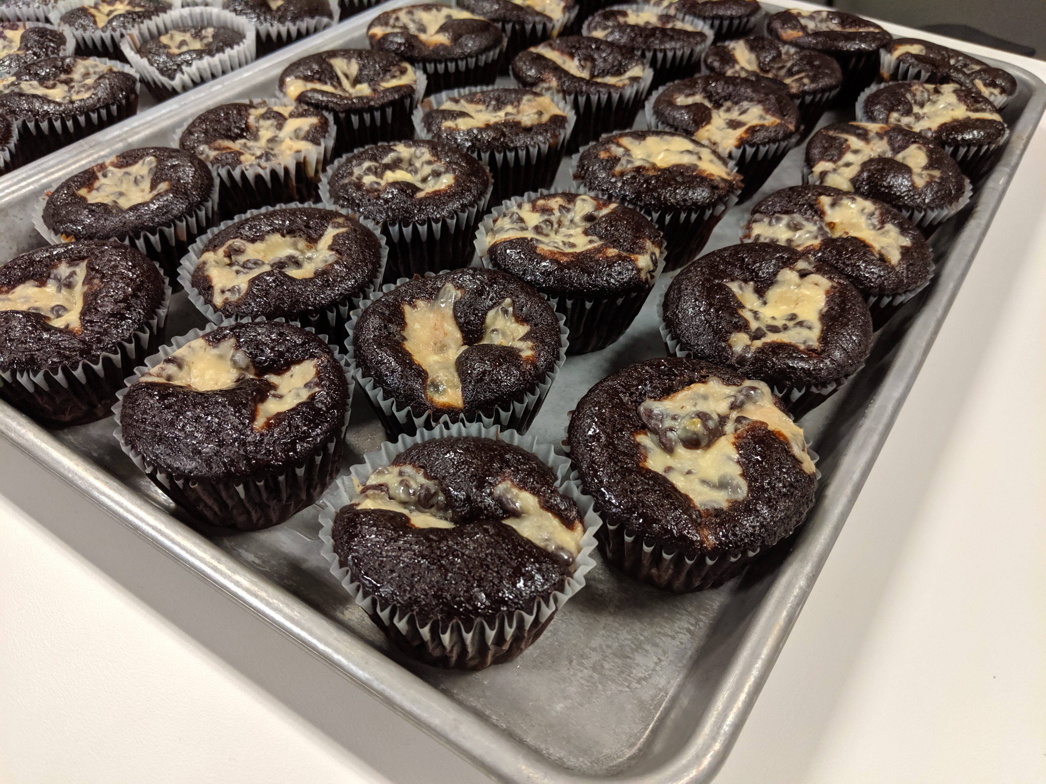
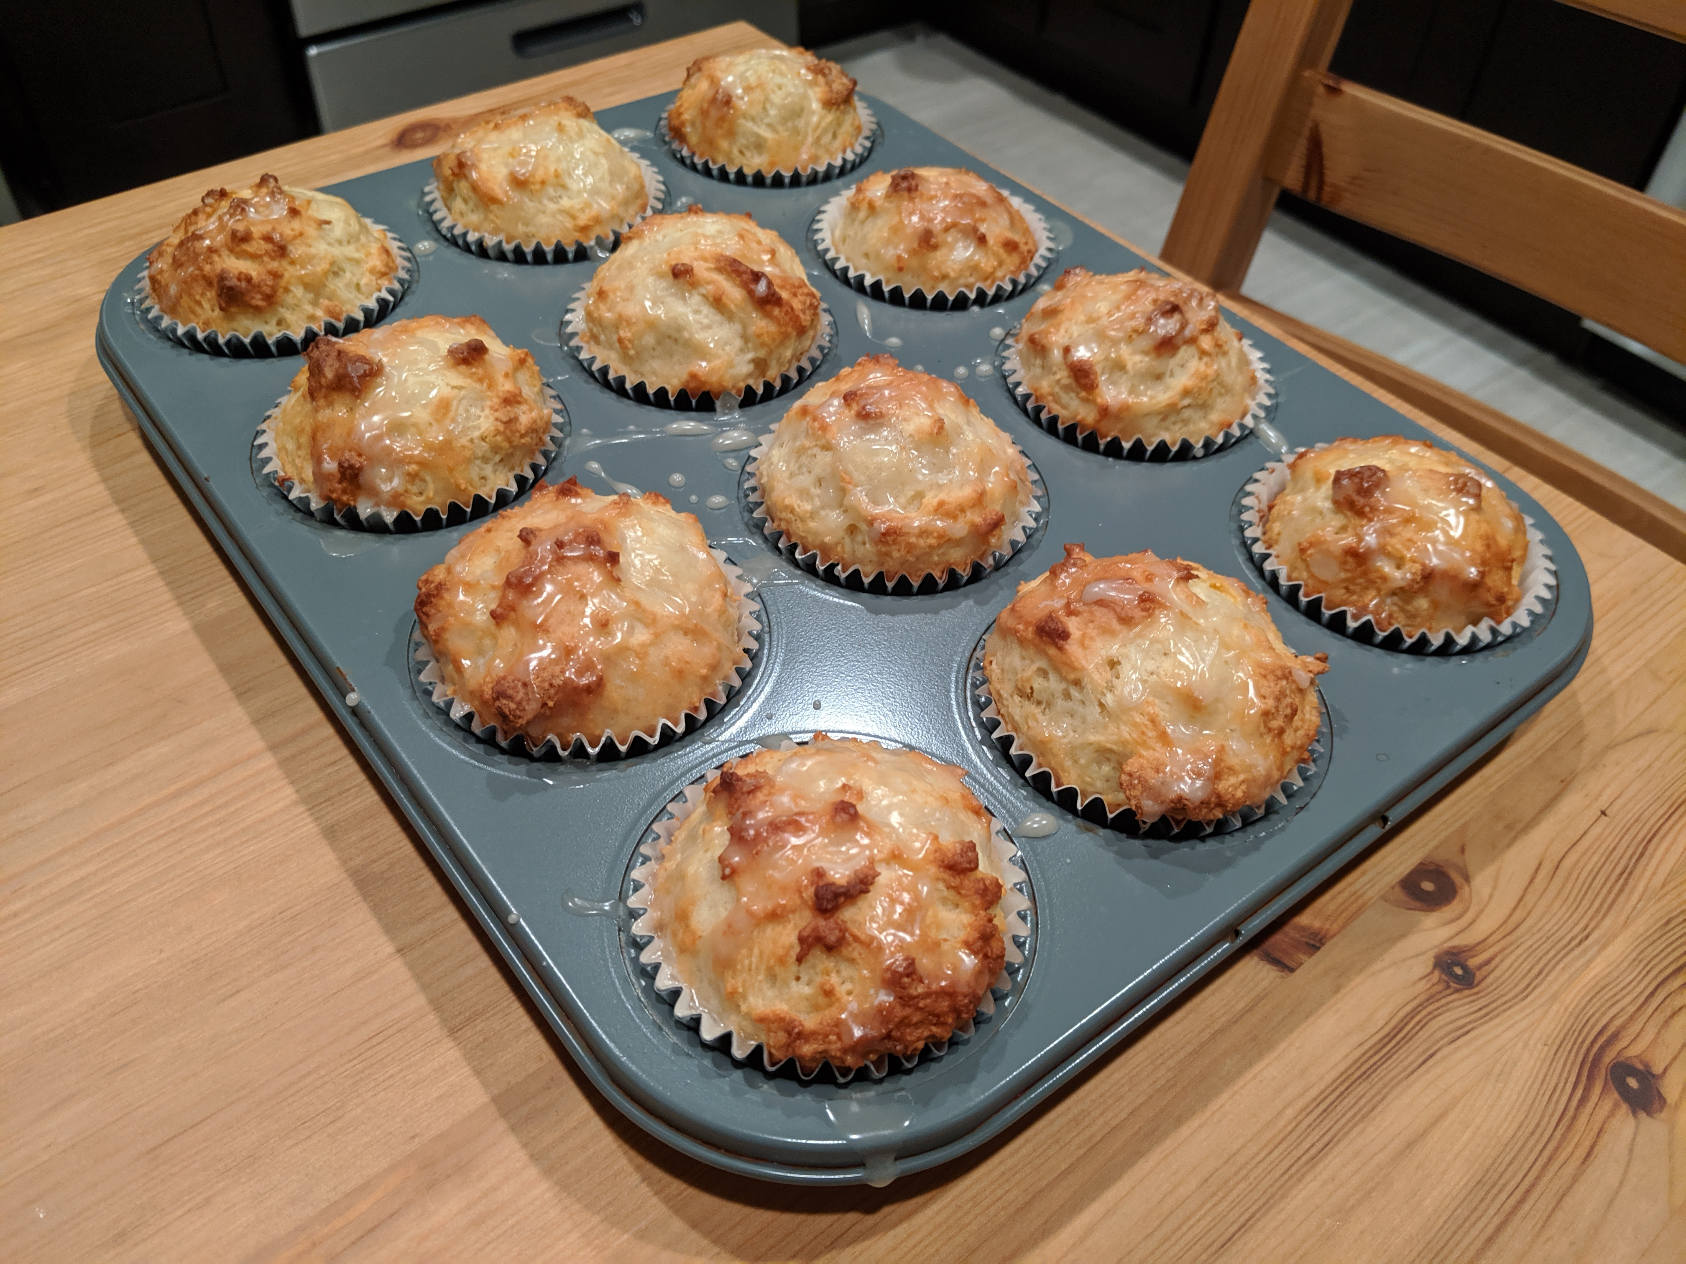

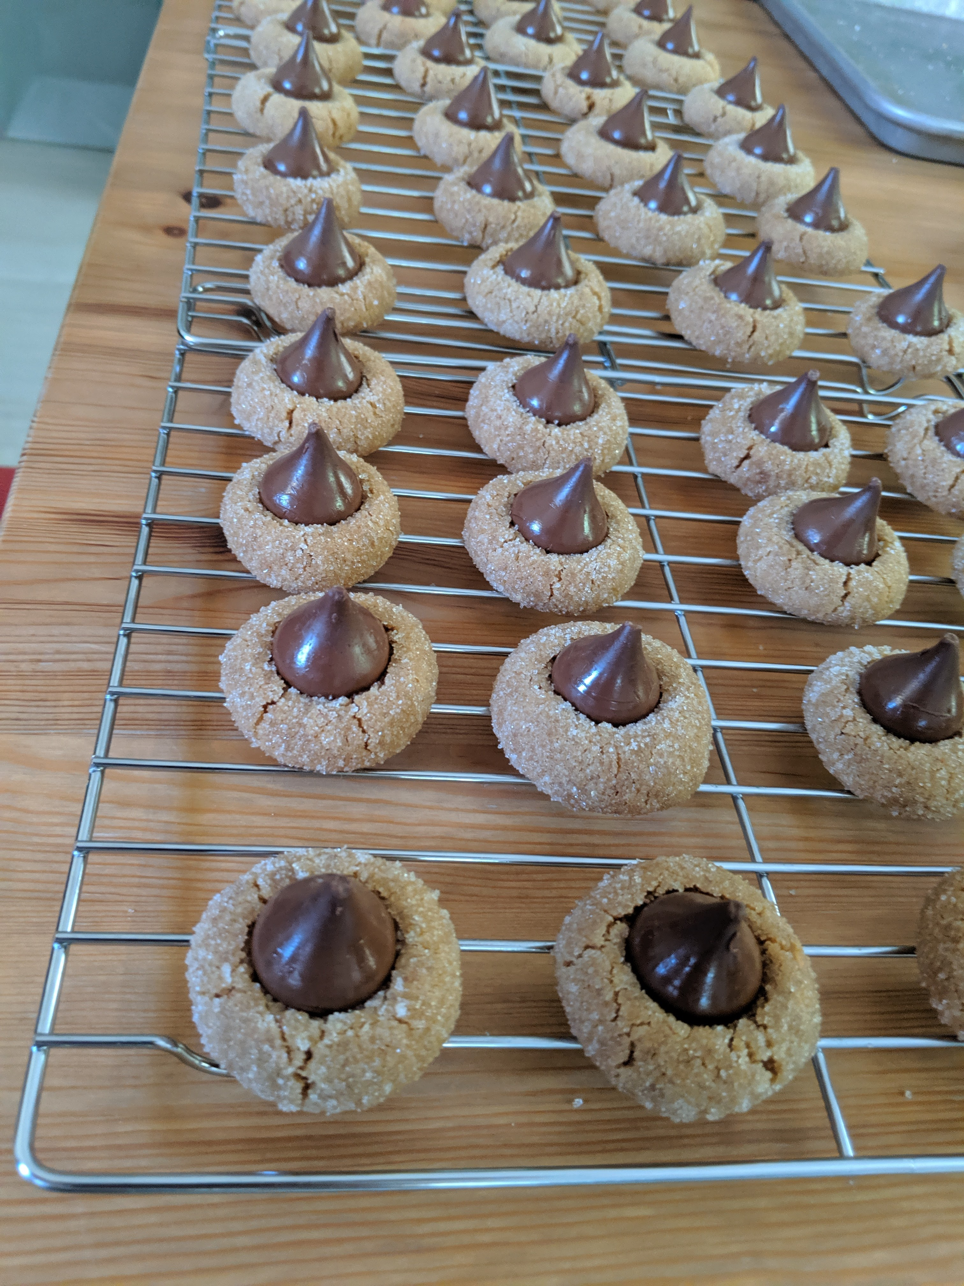
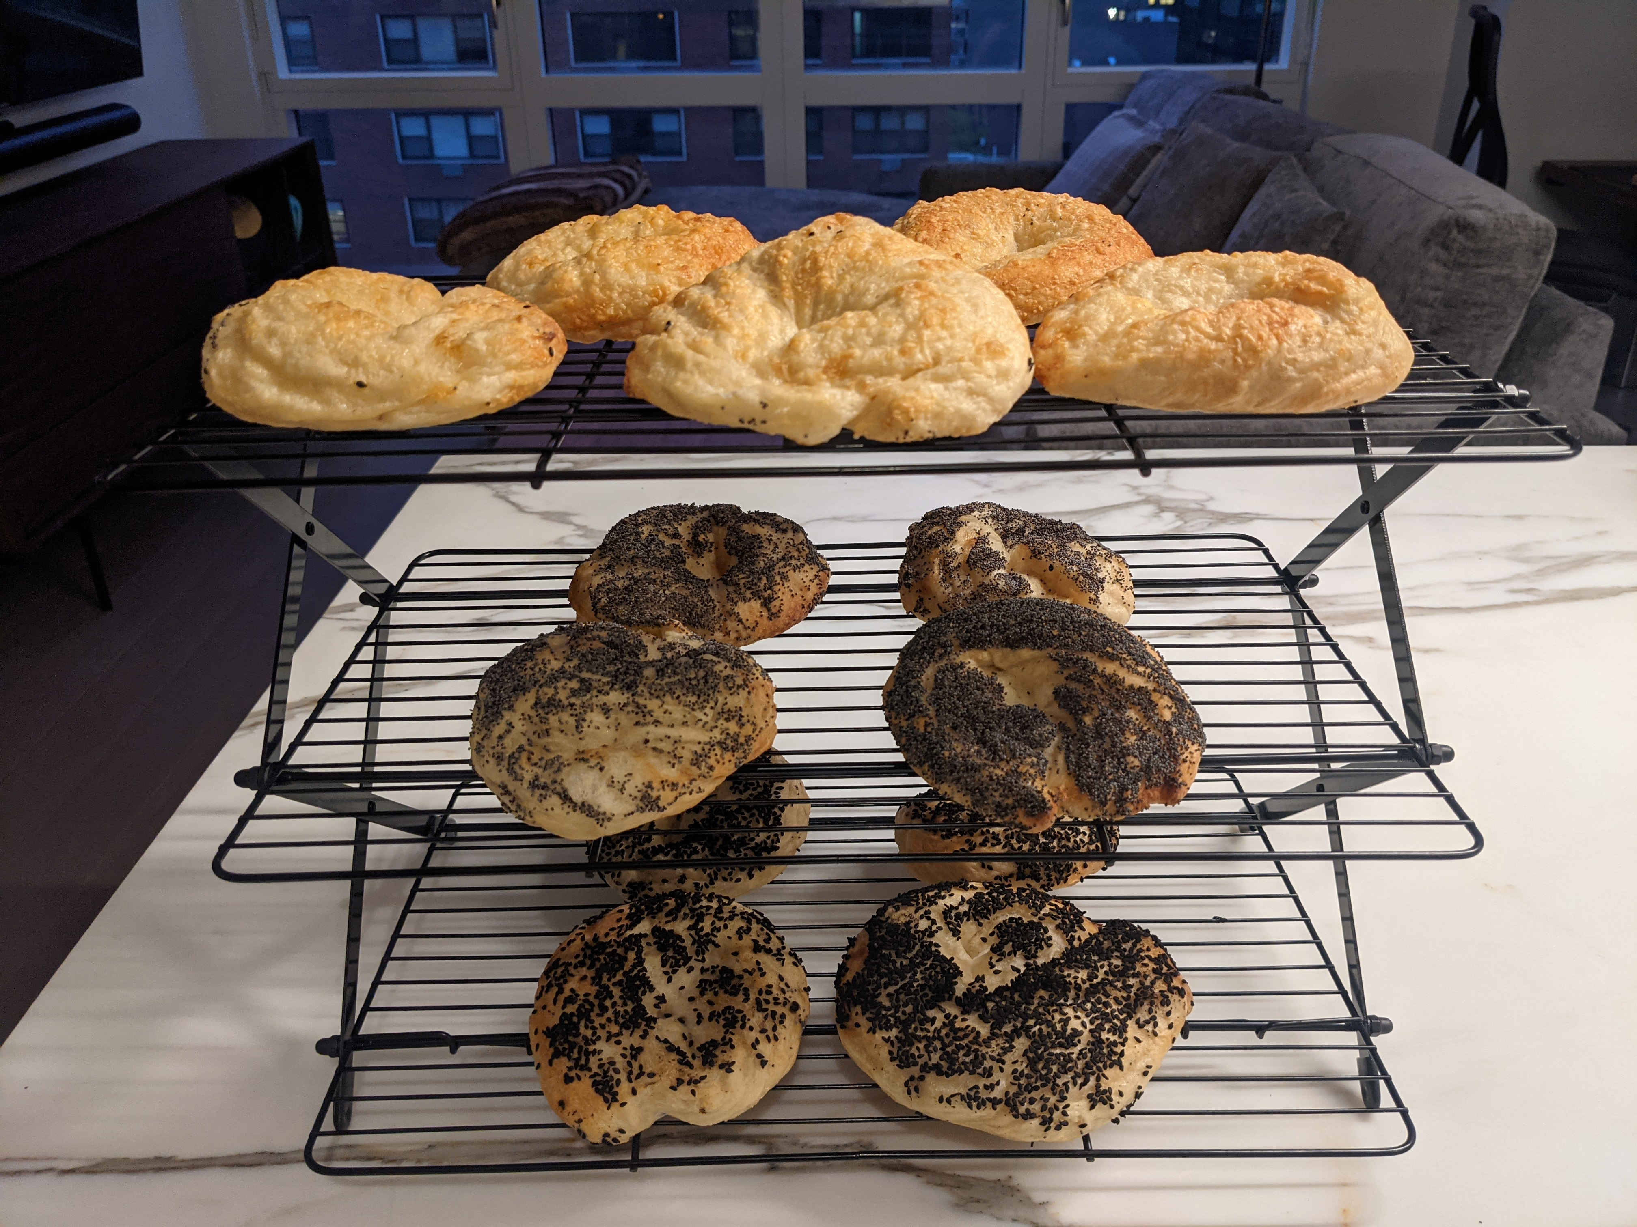
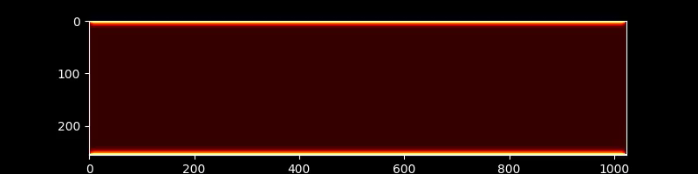
Notes:
Now let's move on to another example working with multidimensional data.
Let's simulate my oven, which has a heating element on top and on bottom.
That's me during the pandemic, with a LOT more hair. The apron was a gift from an intern – it says "I usually cook C++ Standard, but today I'm doing cakes".

Slide 78
(i-1, j-1)
(i-1, j)
(i-1, j+1)
(i-1, j-1)
(i-1, j)
(i-1, j+1)
(i, j-1)
(i, j)
(i, j+1)
(i, j-1)
(i, j)
(i, j+1)
(i+1, j-1)
(i+1, j)
(i+1, j+1)
(i+1, j-1)
(i+1, j)
(i+1, j+1)
Notes:
We'll simulate it on a 2D grid by solving the heat equation numerically with a 5-point stencil.

Slide 79
void heat_equation(auto policy, int nx, int ny,
const thrust::universal_vector<float>& U_data,
thrust::universal_vector<float>& V_data);
Notes:
Our solver function will take a Thrust execution policy, the dimensions of the grid, and two universal vectors – U, which represents the current state, and V, where the next state will be written.

Slide 80
void heat_equation(auto policy, int nx, int ny,
const thrust::universal_vector<float>& U_data,
thrust::universal_vector<float>& V_data) {
…
thrust::for_each_n(policy, thrust::make_counting_iterator(0), U.size(), …);
}
Notes:
We'll use a Thrust `for_each_n` over a counting iterator to implement our stencil.

Slide 81
void heat_equation(auto policy, int nx, int ny,
const thrust::universal_vector<float>& U_data,
thrust::universal_vector<float>& V_data) {
…
thrust::for_each_n(policy, thrust::make_counting_iterator(0), U.size(),
[?, nx, ny] __host__ __device__ (int xy) {
…
});
}
Notes:
The `for_each_n` lambda will need to capture the grid. However, we can't just capture the `universal_vector`s.
If we captured them by value, we'd make copies, which is not what we want.
And we can't capture them by reference for two reasons.
First, while the contents of the vectors can be accessed from the device, the vector object itself may not be in memory that the device can access.
Second, if we capture by reference, we store an address to the vector object. To access the data, we have to load the vector object, get the pointer to the data from it, and then load the data. That's an indirection, which is expensive on GPUs. It's better to just capture the data pointer directly.

Slide 82
void heat_equation(auto policy, int nx, int ny,
const thrust::universal_vector<float>& U_data,
thrust::universal_vector<float>& V_data) {
const float* U = thrust::raw_pointer_cast(U_data.data());
const float* V = thrust::raw_pointer_cast(V_data.data());
thrust::for_each_n(policy, thrust::make_counting_iterator(0), U.size(),
[U, V, nx, ny] __host__ __device__ (int xy) {
…
});
}
Notes:
So, instead, we obtain pointers to the vectors and capture those.

Slide 83
void heat_equation(auto policy, int nx, int ny,
const thrust::universal_vector<float>& U_data,
thrust::universal_vector<float>& V_data) {
const float* U = thrust::raw_pointer_cast(U_data.data());
const float* V = thrust::raw_pointer_cast(V_data.data());
thrust::for_each_n(policy, thrust::make_counting_iterator(0), U.size(),
[U, V, nx, ny] __host__ __device__ (int xy) {
int x = xy / ny;
int y = xy % ny;
…
});
}
Notes:
The first thing we do in the body of the lambda is reconstruct the multidimensional indices from the linear index.

Slide 84
void heat_equation(auto policy, int nx, int ny,
const thrust::universal_vector<float>& U_data,
thrust::universal_vector<float>& V_data) {
const float* U = thrust::raw_pointer_cast(U_data.data());
const float* V = thrust::raw_pointer_cast(V_data.data());
thrust::for_each_n(policy, thrust::make_counting_iterator(0), U.size(),
[U, V, nx, ny] __host__ __device__ (int xy) {
int x = xy / ny;
int y = xy % ny;
if (x > 0 && y > 0 && x < nx - 1 && y < ny - 1) {
…
} else …
});
}
Notes:
Next, we need to check if we're in the interior of the grid, in which case we need to apply the stencil.

Slide 85
void heat_equation(auto policy, int nx, int ny,
const thrust::universal_vector<float>& U_data,
thrust::universal_vector<float>& V_data) {
const float* U = thrust::raw_pointer_cast(U_data.data());
const float* V = thrust::raw_pointer_cast(V_data.data());
thrust::for_each_n(policy, thrust::make_counting_iterator(0), U.size(),
[U, V, nx, ny] __host__ __device__ (int xy) {
int x = xy / ny;
int y = xy % ny;
if (x > 0 && y > 0 && x < nx - 1 && y < ny - 1) {
auto d2tdx2 = U[x*ny + y - 1] - U[x*ny + y] * 2 + U[x*ny + y + 1];
auto d2tdy2 = U[(x - 1)*ny + y] - U[x*ny + y] * 2 + U[(x + 1)*ny + y];
V[x*ny + y] = U[x*ny + y] + 0.2f * (d2tdx2 + d2tdy2);
} else …
});
}
Notes:
Here's the stencil computation itself.

Slide 86
void heat_equation(auto policy, int nx, int ny,
const thrust::universal_vector<float>& U_data,
thrust::universal_vector<float>& V_data) {
const float* U = thrust::raw_pointer_cast(U_data.data());
const float* V = thrust::raw_pointer_cast(V_data.data());
thrust::for_each_n(policy, thrust::make_counting_iterator(0), U.size(),
[U, V, nx, ny] __host__ __device__ (int xy) {
int x = xy / ny;
int y = xy % ny;
if (x > 0 && y > 0 && x < nx - 1 && y < ny - 1) {
auto d2tdx2 = U[x*ny + y - 1] - U[x*ny + y] * 2 + U[x*ny + y + 1];
auto d2tdy2 = U[(x - 1)*ny + y] - U[x*ny + y] * 2 + U[(x + 1)*ny + y];
V[x*ny + y] = U[x*ny + y] + 0.2f * (d2tdx2 + d2tdy2);
} else {
V[x*ny + y] = U[x*ny + y];
}
});
}
Notes:
If we're on the boundary, we don't change anything.
There's a few unfortunate things about this code, such as the repetitive and error-prone multidimensional indexing.
We need a proper abstraction for multidimensional data.

Slide 87
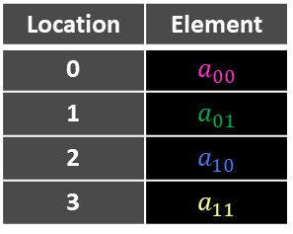
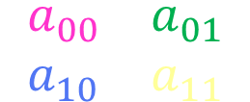
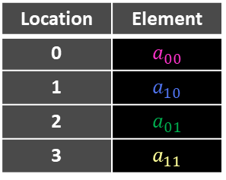
mdspan: A non-owning handle to multidimensional data
template <class T, class Extents, class LayoutPolicy = …, class AccessorPolicy = …>
class std::mdspan;
mdspan A(data, N, M); // Row-major: C/NumPy.
mdspan A(data, layout_right::mapping(dims(N, M)));
A(i, j) == data(i * M + j)
A.stride(0) == M
A.stride(1) == 1
// Column-major: Fortran/MATLAB.
mdspan B(data, layout_left::mapping(dims(N, M)));
B(i, j) == data(i + j * N)
B.stride(0) == 1
B.stride(1) == N
Location | Element
0 | $$a_{00}$$
1 | $$a_{01}$$
2 | $$a_{10}$$
3 | $$a_{11}$$
Location | Element
0 | $$a_{00}$$
1 | $$a_{10}$$
2 | $$a_{01}$$
3 | $$a_{11}$$
$$\left[\begin{matrix}a_{00} & a_{01} \\ a_{10} & a_{11}\end{matrix}\right]$$
Learn More: S51755 C++ Standard Parallelism (2023)
Notes:
That's what the C++ Standard Library's mdspan is. It's a non-owning handle to multidimensional data – basically a pointer plus metadata.
The layout of an mdspan is configurable, and the dimensions can be specified either at runtime or compiletime.
Copying them is cheap and trivial, because you just copy the pointer, not the contents.
mdspan has a powerful slicing facility called submdspan that produces new mdspans that view a subset of the same underlying data.

Slide 88
void heat_equation(auto policy, int nx, int ny,
const thrust::universal_vector<float>& U_data,
thrust::universal_vector<float>& V_data) {
const float* U = thrust::raw_pointer_cast(U_data.data());
const float* V = thrust::raw_pointer_cast(V_data.data());
thrust::for_each_n(policy, thrust::make_counting_iterator(0), U.size(),
[U, V, nx, ny] __host__ __device__ (int xy) {
int x = xy / ny;
int y = xy % ny;
if (x > 0 && y > 0 && x < nx - 1 && y < ny - 1) {
auto d2tdx2 = U[x*ny + y - 1] - U[x*ny + y] * 2 + U[x*ny + y + 1];
auto d2tdy2 = U[(x - 1)*ny + y] - U[x*ny + y] * 2 + U[(x + 1)*ny + y];
V[x*ny + y] = U[x*ny + y] + 0.2f * (d2tdx2 + d2tdy2);
} else {
V[x*ny + y] = U[x*ny + y];
}
});
}
Notes:
Let's rewrite our heat equation solver to use mdspans.

Slide 89
void heat_equation(auto policy,
cuda::std::mdspan<float const, cuda::std::dims<2>> U,
cuda::std::mdspan<float, cuda::std::dims<2>> V) {
thrust::for_each_n(policy, thrust::make_counting_iterator(0), U.size(),
[U, V] __host__ __device__ (int xy) {
int x = xy / U.extent(1);
int y = xy % U.extent(1);
if (x > 0 && y > 0 && x < I.extent(0) - 1 && y < U.extent(1) - 1) {
auto d2tdx2 = U(x, y - 1) - U(x, y) * 2 + U(x, y + 1);
auto d2tdy2 = U(x - 1, y) - U(x, y) * 2 + U(x + 1, y);
V(x, y) = U(x, y) + 0.2f * (d2tdx2 + d2tdy2);
} else {
V(x, y) = U(x, y);
}
});
}
Notes:
Instead of taking universal_vectors and obtaining pointers to them that we can capture, we just take mdspans, which can be captured by value and copied to the device.
We replace the manual indexing with calls to mdspan's index operator with the multidimensional coordinates.

Slide 90
void initialize_oven(auto policy, cuda::std::mdspan<float, cuda::std::dims<2>> U);
Notes:
Now, let's write a function to set up the initial state. It will take a policy and an mdspan to initialize.
We can break the grid down into three regions that we need to set.

Slide 91
void initialize_oven(auto policy, cuda::std::mdspan<float, cuda::std::dims<2>> U) {
auto nx = U.extent(0);
auto top = cuda::std::submdspan(U, 0, cuda::std::full_extent);
auto bot = cuda::std::submdspan(U, nx-1, cuda::std::full_extent);
}
Notes:
We'll use submdspan, the mdspan slicing operation, to obtain mdspans to these three regions.
submdspan takes an mdspan, and one slice specifier for each dimension, which indicates which indices from that dimension should be selected. A slice specifier could be a single index, a range of indices (optionally with a stride), or the entire dimension (which is indicated by `full_extent`).
The first two regions we need are the row at the top of the grid and the row at the bottom of the grid.

Slide 92
void initialize_oven(auto policy, cuda::std::mdspan<float, cuda::std::dims<2>> U) {
auto nx = U.extent(0);
auto top = cuda::std::submdspan(U, 0, cuda::std::full_extent);
auto mid = cuda::std::submdspan(U, cuda::std::tuple(1, nx-2), cuda::std::full_extent);
auto bot = cuda::std::submdspan(U, nx-1, cuda::std::full_extent);
}
Notes:
The last region is the interior points – everything except for the first and last row.

Slide 93
void initialize_oven(auto policy, cuda::std::mdspan<float, cuda::std::dims<2>> U) {
auto nx = U.extent(0);
auto top = cuda::std::submdspan(U, 0, cuda::std::full_extent);
auto mid = cuda::std::submdspan(U, cuda::std::tuple(1, nx-2), cuda::std::full_extent);
auto bot = cuda::std::submdspan(U, nx-1, cuda::std::full_extent);
thrust::fill_n(policy, top.data_handle(), top.size(), 90.0);
thrust::fill_n(policy, bot.data_handle(), bot.size(), 90.0);
}
Notes:
We'll set the top and bottom row to a high temperature.

Slide 94
void initialize_oven(auto policy, cuda::std::mdspan<float, cuda::std::dims<2>> U) {
auto nx = U.extent(0);
auto top = cuda::std::submdspan(U, 0, cuda::std::full_extent);
auto mid = cuda::std::submdspan(U, cuda::std::tuple(1, nx-2), cuda::std::full_extent);
auto bot = cuda::std::submdspan(U, nx-1, cuda::std::full_extent);
thrust::fill_n(policy, top.data_handle(), top.size(), 90.0);
thrust::fill_n(policy, mid.data_handle(), mid.size(), 15.0);
thrust::fill_n(policy, bot.data_handle(), bot.size(), 90.0);
}
Notes:
And we'll set the interior region to a lower temperature.

Slide 95
int nx(…), ny(…), write_steps(…), compute_steps(…);
Notes:
Now we'll write the time stepping loop that repeatedly calls the solver.
We'll output the state of the system periodically during the loop. After every "compute_steps" evaluations, we'll do one output. In total, we'll do "write_steps" times "compute_steps" iterations.

Slide 96
int nx(…), ny(…), write_steps(…), compute_steps(…);
thrust::universal_vector<float> U_data(nx * ny), V_data(nx * ny);
cuda::std::mdspan U(thrust::raw_pointer_cast(U_data.data()), nx, ny);
cuda::std::mdspan V(thrust::raw_pointer_cast(V_data.data()), nx, ny);
Notes:
We'll start by setting up our two universal vectors and constructing mdspans to them.

Slide 97
int nx(…), ny(…), write_steps(…), compute_steps(…);
thrust::universal_vector<float> U_data(nx * ny), V_data(nx * ny);
cuda::std::mdspan U(thrust::raw_pointer_cast(U_data.data()), nx, ny);
cuda::std::mdspan V(thrust::raw_pointer_cast(V_data.data()), nx, ny);
initialize_oven(thrust::cuda::par, U);
Notes:
Then we'll initialize U with the function we just wrote.

Slide 98
int nx(…), ny(…), write_steps(…), compute_steps(…);
thrust::universal_vector<float> U_data(nx * ny), V_data(nx * ny);
cuda::std::mdspan U(thrust::raw_pointer_cast(U_data.data()), nx, ny);
cuda::std::mdspan V(thrust::raw_pointer_cast(V_data.data()), nx, ny);
initialize_oven(thrust::cuda::par, U);
for (auto write_step : std::views::iota(0, write_steps)) {
…
}
Notes:
Next, every write step…

Slide 99
int nx(…), ny(…), write_steps(…), compute_steps(…);
thrust::universal_vector<float> U_data(nx * ny), V_data(nx * ny);
cuda::std::mdspan U(thrust::raw_pointer_cast(U_data.data()), nx, ny);
cuda::std::mdspan V(thrust::raw_pointer_cast(V_data.data()), nx, ny);
initialize_oven(thrust::cuda::par, U);
for (auto write_step : std::views::iota(0, write_steps)) {
save_to_file(U);
for (auto compute_step : std::views::iota(0, compute_steps)) {
…
}
}
Notes:
We'll save the current state by calling some `save_to_file` function on U.
Then, for every compute step…

Slide 100
int nx(…), ny(…), write_steps(…), compute_steps(…);
thrust::universal_vector<float> U_data(nx * ny), V_data(nx * ny);
cuda::std::mdspan U(thrust::raw_pointer_cast(U_data.data()), nx, ny);
cuda::std::mdspan V(thrust::raw_pointer_cast(V_data.data()), nx, ny);
initialize_oven(thrust::cuda::par, U);
for (auto write_step : std::views::iota(0, write_steps)) {
save_to_file(U);
for (auto compute_step : std::views::iota(0, compute_steps)) {
heat_equation(thrust::cuda::par, U, V);
…
}
}
Notes:
We'll call our solver function with U as the input and V as the output.

Slide 101
int nx(…), ny(…), write_steps(…), compute_steps(…);
thrust::universal_vector<float> U_data(nx * ny), V_data(nx * ny);
cuda::std::mdspan U(thrust::raw_pointer_cast(U_data.data()), nx, ny);
cuda::std::mdspan V(thrust::raw_pointer_cast(V_data.data()), nx, ny);
initialize_oven(thrust::cuda::par, U);
for (auto write_step : std::views::iota(0, write_steps)) {
save_to_file(U);
for (auto compute_step : std::views::iota(0, compute_steps)) {
heat_equation(thrust::cuda::par, U, V);
U.swap(V);
}
}
Notes:
Then we'll set the new state from the solve as the input for the next solve by swapping U and V.
Remember, U and V are mdspans, which are essentially just pointers. This swap just changes what U and V point to. It doesn't modify the data at all!

Slide 102
int nx(…), ny(…), write_steps(…), compute_steps(…);
thrust::universal_vector<float> U_data(nx * ny), V_data(nx * ny);
cuda::std::mdspan U(thrust::raw_pointer_cast(U_data.data()), nx, ny);
cuda::std::mdspan V(thrust::raw_pointer_cast(V_data.data()), nx, ny);
initialize_oven(thrust::cuda::par, U);
for (auto write_step : std::views::iota(0, write_steps)) {
save_to_file(U);
for (auto compute_step : std::views::iota(0, compute_steps)) {
heat_equation(thrust::cuda::par, U, V);
U.swap(V);
}
}
heat_equation(…, U_data.data(), V_data.data());
heat_equation(…, V_data.data(), U_data.data());
heat_equation(…, U_data.data(), V_data.data());
Notes:
We do this because in the first iteration, we want to call heat_equation(U_data, V_data), then we want to call heat_equation(V_data, U_data), then heat_equation(U_data, V_data), etc.

Slide 103
compute_step = 0;
heat_equation(thrust::cuda::par, U, V);
U.swap(V);
compute_step = 1;
heat_equation(thrust::cuda::par, U, V);
U.swap(V);
Host
Blocked
Launch heat_equation
compute_step == 0
Blocked
Launch heat_equation
compute_step == 1
Notes:
As we discussed earlier, Thrust algorithms are all fork-join synchronous by default.
They launch the device work, and then they wait until that work has completed before they return to the caller.
This introduces unnecessary waiting on the host and underutilization of the device, because we can't launch the next piece of work until the first one finishes.
We want to be able to overlap the latency of launching device work so that our GPU will always have work in the queue and reach maximum utilization.

Slide 104
int nx(…), ny(…), write_steps(…), compute_steps(…);
thrust::universal_vector<float> U_data(nx * ny), V_data(nx * ny);
cuda::std::mdspan U(thrust::raw_pointer_cast(U_data.data()), nx, ny);
cuda::std::mdspan V(thrust::raw_pointer_cast(V_data.data()), nx, ny);
initialize_oven(thrust::cuda::par, U);
for (auto write_step : std::views::iota(0, write_steps)) {
save_to_file(U);
for (auto compute_step : std::views::iota(0, compute_steps)) {
heat_equation(thrust::cuda::par, U, V);
U.swap(V);
}
}
Notes:
That means we need asynchrony, and for that, we'll have to change the execution policy that we're using.

Slide 105
int nx(…), ny(…), write_steps(…), compute_steps(…);
thrust::universal_vector<float> U_data(nx * ny), V_data(nx * ny);
cuda::std::mdspan U(thrust::raw_pointer_cast(U_data.data()), nx, ny);
cuda::std::mdspan V(thrust::raw_pointer_cast(V_data.data()), nx, ny);
initialize_oven(thrust::cuda::par_nosync, U);
for (auto write_step : std::views::iota(0, write_steps)) {
save_to_file(U);
for (auto compute_step : std::views::iota(0, compute_steps)) {
heat_equation(thrust::cuda::par_nosync, U, V);
U.swap(V);
}
}
Notes:
The thrust::cuda::par_nosync policy will cause algorithms to NOT wait for the device work it launchs.
The algorithm invocations will return immediately, and the caller will be responsible for synchronizing later.

Slide 106
int nx(…), ny(…), write_steps(…), compute_steps(…);
thrust::universal_vector<float> U_data(nx * ny), V_data(nx * ny);
cuda::std::mdspan U(thrust::raw_pointer_cast(U_data.data()), nx, ny);
cuda::std::mdspan V(thrust::raw_pointer_cast(V_data.data()), nx, ny);
initialize_oven(thrust::cuda::par_nosync, U);
for (auto write_step : std::views::iota(0, write_steps)) {
cudaDeviceSynchronize();
save_to_file(U);
for (auto compute_step : std::views::iota(0, compute_steps)) {
heat_equation(thrust::cuda::par_nosync, U, V);
U.swap(V);
}
}
Notes:
In our case, we'll need to wait on all device work every write step before we call `save_to_file`, to ensure that the last compute step has completed before we begin writing.
This is a good start to making our code asynchronous. The next step is to use CUDA streams.

Slide 107
auto pol(thrust::cuda::par_nosync);
cudax::stream A;
thrust::for_each(pol.on(A), …, f);
thrust::for_each(pol.on(A), …, g);
GPU
A stream is a chain of device work that is executed in order.
Stream A
Run f
Run g
Notes:
A stream is a chain of device work that is executed in order. You can think of it like a queue.
You can have Thrust launch work on a specific stream by passing the stream to the `on` method of the execution policy.
Here, we asynchronously launch a for_each applying `f` and a for_each applying `g` on the device. The `f` for_each will complete execution before the `g` for_each starts.

Slide 108
auto pol(thrust::cuda::par_nosync);
cudax::stream A;
thrust::for_each(pol.on(A), …, f);
thrust::for_each(pol.on(A), …, g);
A.sync();
GPU
A stream is a chain of device work that is executed in order.
Stream A
Run f
They can record events that host code can sync with.
Run g
Record …
Notes:
A stream can record an event that host code can synchronize with, waiting for all work up until that event to complete.
You can do this in code by simply calling `sync` on the stream object.
In this case, it'll block until both `for_each`s complete.

Slide 109
auto pol(thrust::cuda::par_nosync);
cudax::stream A;
thrust::for_each(pol.on(A), …, f);
A.sync();
thrust::for_each(pol.on(A), …, g);
GPU
A stream is a chain of device work that is executed in order.
Stream A
Run f
They can record events that host code can sync with.
Record …
Run g
Notes:
If we instead sync before the call to the `g` for_each, we'll only block on the `f` for_each.

Slide 110
auto pol(thrust::cuda::par_nosync);
cudax::stream A;
thrust::for_each(pol.on(A), …, f);
A.sync();
thrust::for_each(pol.on(A), …, g);
cudax::stream B;
thrust::for_each(pol.on(B), …, x);
thrust::for_each(pol.on(B), …, y);
thrust::for_each(pol.on(B), …, z);
GPU
Stream A
Run f
Stream B
Record …
Run g
Run x
Run y
Run z
Notes:
You can create multiple streams that run concurrently on a single device, just as you can run multiple threads concurrently on a single host.

Slide 111
auto pol(thrust::cuda::par_nosync);
cudax::stream A;
thrust::for_each(pol.on(A), …, f);
A.sync();
thrust::for_each(pol.on(A), …, g);
cudax::stream B;
thrust::for_each(pol.on(B), …, x);
thrust::for_each(pol.on(B), …, y);
auto e = B.record_event();
thrust::for_each(pol.on(B), …, z);
cudax::stream C;
thrust::copy(pol.on(C), M, …, N);
C.wait(e);
thrust::for_each(pol.on(C), … h);
A stream can record events that other streams and host code can sync with.
GPU
Stream A
Run f
Stream B
Record …
Run g
Run x
Run y
Stream C
Record e
Run z
Copy M to N
Wait for e
Run h
Notes:
Streams can wait upon other streams through events.
You can explicitly record an event on one stream with the `record_event` method, and you can have another stream wait for that event by calling the `wait` method on the stream and passing it an event.
Note that the host will NOT block on the event when you call this form of wait – it will just tell the stream to block on the event.

Slide 112
auto pol(thrust::cuda::par_nosync);
cudax::stream A(cudax::devices[0]);
thrust::for_each(pol.on(A), …, f);
A.sync();
thrust::for_each(pol.on(A), …, g);
cudax::stream B(cudax::devices[1]);
thrust::for_each(pol.on(B), …, x);
thrust::for_each(pol.on(B), …, y);
auto e = B.record_event();
thrust::for_each(pol.on(B), …, z);
cudax::stream C(cudax::devices[0]);
thrust::copy(pol.on(C), M, …, N);
C.wait(e);
thrust::for_each(pol.on(C), … h);
GPU 0
GPU 1
Stream A
Run f
Stream B
Record …
Run g
Run x
Run y
Stream C
Record e
Run z
Copy M to N
Wait for e
Run h
Notes:
You can use streams to control what specific device your code runs on.
By default, they're constructed on the first device, but you can explicitly construct them on any device on your system.
Dependencies can be established between streams running on different devices.

Slide 113
int nx(…), ny(…), write_steps(…), compute_steps(…);
thrust::universal_vector<float> U_data(nx * ny), V_data(nx * ny);
cuda::std::mdspan U(…), V(…);
initialize_oven(thrust::cuda::par_nosync, U);
for (auto write_step : std::views::iota(0, write_steps)) {
cudaDeviceSynchronize();
save_to_file(U);
for (auto compute_step : std::views::iota(0, compute_steps)) {
heat_equation(thrust::cuda::par_nosync, U, V);
U.swap(V);
}
}
Notes:
Let's revisit our heat equation example and add streams.

Slide 114
int nx(…), ny(…), write_steps(…), compute_steps(…);
cudax::stream stream;
auto policy(thrust::cuda::par_nosync.on(stream.get());
thrust::universal_vector<float> U_data(nx * ny), V_data(nx * ny);
cuda::std::mdspan U(…), V(…);
initialize_oven(policy, U);
for (auto write_step : std::views::iota(0, write_steps)) {
stream.sync();
save_to_file(U);
for (auto compute_step : std::views::iota(0, compute_steps)) {
heat_equation(policy, U, V);
U.swap(V);
}
}
Notes:
We'll create a stream, define an asynchronous policy that will run on that stream, and then use that policy in all of our calls to Thrust.
Instead of synchronizing with all work on the device at the start of each write step, we'll just sync for the work on our stream.

Slide 115
auto policy = thrust::cuda::par_nosync;
thrust::universal_vector A(…), B(…);
thrust::for_each_n(
policy, A.begin(), A.size(), f0);
// Doesn't return anything.
auto it1 = thrust::transform(policy,
A.begin(), A.end(), B.begin(), f1);
// Returns an iterator to the end of the output (B).
// Doesn't depend on the computation; it's just B.begin() + A.size().
Notes:
There are some limits to Thrust's support for asynchrony.
It works great for algorithms like `for_each` and `transform`.

Slide 116
auto policy = thrust::cuda::par_nosync;
thrust::universal_vector A(…), B(…);
thrust::for_each_n(
policy, A.begin(), A.size(), f0);
// Doesn't return anything.
auto it1 = thrust::transform(policy,
A.begin(), A.end(), B.begin(), f1);
// Returns an iterator to the end of the output (B).
// Doesn't depend on the computation; it's just B.begin() + A.size().
Some Thrust algorithms return a result that depends on the computation. These interfaces will always block.
Notes:
But some Thrust algorithms return a result that depends on the computation.
Today, these interfaces will always block, even with the `par_nosync` policy.

Slide 117
auto policy = thrust::cuda::par_nosync;
thrust::universal_vector A(…), B(…);
thrust::for_each_n(
policy, A.begin(), A.size(), f0);
// Doesn't return anything.
auto it1 = thrust::transform(policy,
A.begin(), A.end(), B.begin(), f1);
// Returns an iterator to the end of the output (B).
// Doesn't depend on the computation; it's just B.begin() + A.size().
auto it2 = thrust::inclusive_scan(policy, A.begin(), A.end(), B.begin(), f2);
// Also returns the end of the output, but needs temporary storage.
Some Thrust algorithms return a result that depends on the computation. These interfaces will always block.
Notes:
Algorithms like `inclusive_scan` are fine - in recent versions of Thrust, they will not block with `par_nosync`.
`inclusive_scan` returns an iterator to the end of the output – this doesn't depend on the computation, so we can just compute it beforehand by incrementing the output iterator by the size of the input.
Unlike `for_each` and `transform`, scan algorithms require temporary storage. Thrust must allocate and deallocate this storage before the algorithm returns.
This used to block in Thrust, but now with the `par_nosync` policy, it will use CUDA's non-blocking allocation API by default. If you pass your own allocator to the execution policy and that allocator blocks when allocating or deallocating, then you'll still get blocking.

Slide 118
auto policy = thrust::cuda::par_nosync;
thrust::universal_vector A(…), B(…);
thrust::for_each_n(
policy, A.begin(), A.size(), f0);
// Doesn't return anything.
auto it1 = thrust::transform(policy,
A.begin(), A.end(), B.begin(), f1);
// Returns an iterator to the end of the output (B).
// Doesn't depend on the computation; it's just B.begin() + A.size().
auto it2 = thrust::inclusive_scan(policy, A.begin(), A.end(), B.begin(), f2);
// Also returns the end of the output, but needs temporary storage.
auto it3 = thrust::copy_if(policy, A.begin(), A.end(), B.begin(), f3);
// Returns the end of the output, but it depends on the computation.
Some Thrust algorithms return a result that depends on the computation. These interfaces will always block.
Notes:
Algorithms like `copy_if` return an iterator to the end of the output – but that depends on how many elements pass the predicate, which we won't know until the computation is complete.
So, Thrust must block before returning from these algorithms, even with the `par_nosync` policy.

Slide 119
auto policy = thrust::cuda::par_nosync;
thrust::universal_vector A(…), B(…);
thrust::for_each_n(
policy, A.begin(), A.size(), f0);
// Doesn't return anything.
auto it1 = thrust::transform(policy,
A.begin(), A.end(), B.begin(), f1);
// Returns an iterator to the end of the output (B).
// Doesn't depend on the computation; it's just B.begin() + A.size().
auto it2 = thrust::inclusive_scan(policy, A.begin(), A.end(), B.begin(), f2);
// Also returns the end of the output, but needs temporary storage.
auto it3 = thrust::copy_if(policy, A.begin(), A.end(), B.begin(), f3);
// Returns the end of the output, but it depends on the computation.
auto r4 = thrust::reduce(policy, A.begin(), A.end(), T{}, f4);
auto r5 = thrust::find_if(policy, A.begin(), A.end(), f5);
// Returns the result of the computation itself.
Some Thrust algorithms return a result that depends on the computation. These interfaces will always block.
Notes:
Reduction-based algorithms like `reduce`, `count`, `find_if`, and `max_element` return the result of the reduction, which requires blocking.
If we need asynchronous versions of these algorithms today, there's another, lower level CUDA C++ algorithms library that we can use that is asynchronous from the ground up.

Slide 120

The CUDA C++ Algorithm Authoring Toolkit
https://nvidia.github.io/cccl/cub
Learn More: S72575 How You Should Write a CUDA C++ Kernel
Device-Wide Kernels
cub::DeviceSegmentedReduce
cub::DeviceHistogram
cub::DeviceRadixSort
cub::DeviceSelect
...
Block-Wide Cooperative Primitives
cub::BlockReduce
cub::BlockExchange
cub::BlockRunLengthDecode
cub::BlockLoad/Store
...
Warp-Wide Cooperative Primitives
cub::WarpReduce
cub::WarpExchange
cub::WarpMergeSort
cub::WarpLoad/Store
...
Per-Thread Primitives
cub::ThreadReduce
cub::ThreadScan
cub::MergePathSearch
cub::ThreadLoad/Store
...
Notes:
That library is CUB, the CUDA C++ algorithm authoring toolkit.
CUB provides cooperative building blocks for writing your own device-side parallel algorithms.
But that's not the focus of our talk today. However, if you're interested in that, there was a great talk at NVIDIA's GTC conference this year about writing CUDA C++ kernels that covers how to use CUB.

Slide 121
The CUDA C++ Algorithm Authoring Toolkit
https://nvidia.github.io/cccl/cub
Learn More: S72575 How You Should Write a CUDA C++ Kernel
Device-Wide Kernels
cub::DeviceSegmentedReduce
cub::DeviceHistogram
cub::DeviceRadixSort
cub::DeviceSelect
...
Block-Wide Cooperative Primitives
cub::BlockReduce
cub::BlockExchange
cub::BlockRunLengthDecode
cub::BlockLoad/Store
...
Warp-Wide Cooperative Primitives
cub::WarpReduce
cub::WarpExchange
cub::WarpMergeSort
cub::WarpLoad/Store
...
Per-Thread Primitives
cub::ThreadReduce
cub::ThreadScan
cub::MergePathSearch
cub::ThreadLoad/Store
...
Notes:
But CUB also exposes device-wide algorithms that you launch from the host, just like Thrust, and that's the part of CUB we'll cover in this talk.

Slide 122
thrust::universal_vector X(…);
auto res = thrust::reduce(
thrust::cuda::par,
X.begin(), X.end(),
T{}, cuda::maximum{});
Notes:
As I said, CUB is a bit lower level than Thrust.
We just discussed how some Thrust algorithms need to allocate temporary storage, for example reductions.

Slide 123



1st Kernel
$$O\left(input\right)→O(blocks)$$
2nd Kernel
$$O\left(blocks\right)→1$$
Block 0
X[0]
X[1]
X[2]
thrust::universal_vector X(…);
auto res = thrust::reduce(
thrust::cuda::par,
X.begin(), X.end(),
T{}, cuda::maximum{});
Single Block
Block 1
X[3]
X[0:2]
X[4]
X[3:5]
X[5]
X[6:8]
Block 3
X[6]
$O\left(blocks\right)$ temporary storage required for block sums.
X[7]
X[8]
Notes:
We implement GPU reductions with two passes.
The first pass divides the input up into chunks, each of which is handled by a block of threads, which will collectively reduce the entire chunk to a single value that is stored in a temporary array.
A second pass will then use a single block of threads to reduce the aggregates in the temporary array to a single result.
With Thrust, the temporary array allocation and deallocation is done implicitly within the algorithm.

Slide 124
thrust::universal_vector X(…);
thrust::universal_vector res(1);
thrust::universal_vector X(…);
auto res = thrust::reduce(
thrust::cuda::par,
X.begin(), X.end(),
T{}, cuda::maximum{});
Notes:
CUB is asynchronous by design, so it doesn't return the reduction result by value – instead it takes an iterator and assigns the reduction result to that iterator.
So, when we call a CUB reduction, we need some device accessible storage for the result.

Slide 125
thrust::universal_vector X(…);
thrust::universal_vector res(1);
// Determine temporary storage size.
// Doesn't launch anything.
int tmp_size = 0;
cub::DeviceReduce::Reduce(
nullptr,
tmp_size,
X.begin(), res.begin(), X.size(),
cuda::maximum{}, T{});
thrust::universal_vector X(…);
auto res = thrust::reduce(
thrust::cuda::par,
X.begin(), X.end(),
T{}, cuda::maximum{});
Notes:
With CUB today, we must allocate the temporary storage explicitly.
But first, we have to determine how much temporary storage we'll need. This is not trivial to figure out, because it will depend on the algorithm, data types, operators, and device architecture.
Since you need the same information that you'd invoke the algorithm with to compute the temporary storage size, we use the same interface to do both.

Slide 126
thrust::universal_vector X(…);
thrust::universal_vector res(1);
// Determine temporary storage size.
// Doesn't launch anything.
int tmp_size = 0;
cub::DeviceReduce::Reduce(
nullptr,
tmp_size,
X.begin(), res.begin(), X.size(),
cuda::maximum{}, T{});
thrust::universal_vector X(…);
auto res = thrust::reduce(
thrust::cuda::par,
X.begin(), X.end(),
T{}, cuda::maximum{});
Notes:
The first two parameters to a CUB algorithm are a pointer to temporary storage and a reference to the temporary storage size.
If the pointer to temporary storage is null, then the algorithm will NOT be invoked, but instead the temporary storage size will be computed and assigned to the integral reference you passed in.

Slide 127
thrust::universal_vector X(…);
thrust::universal_vector res(1);
// Determine temporary storage size.
// Doesn't launch anything.
int tmp_size = 0;
cub::DeviceReduce::Reduce(
nullptr,
tmp_size,
X.begin(), res.begin(), X.size(),
cuda::maximum{}, T{});
thrust::device_vector<cuda::std::byte>
tmp(tmp_size);
thrust::universal_vector X(…);
auto res = thrust::reduce(
thrust::cuda::par,
X.begin(), X.end(),
T{}, cuda::maximum{});
Notes:
Next, we need to allocate the temporary storage, which we can do with a vector of `cuda::std::byte`s.

Slide 128
thrust::universal_vector X(…);
thrust::universal_vector res(1);
// Determine temporary storage size.
// Doesn't launch anything.
int tmp_size = 0;
cub::DeviceReduce::Reduce(
nullptr,
tmp_size,
X.begin(), res.begin(), X.size(),
cuda::maximum{}, T{});
thrust::device_vector<cuda::std::byte>
tmp(tmp_size);
// Launch kernel.
cub::DeviceReduce::Reduce(
thrust::raw_pointer_cast(tmp.data()),
tmp_size,
X.begin(), res.begin(), X.size(),
cuda::maximum{}, T{});
thrust::universal_vector X(…);
auto res = thrust::reduce(
thrust::cuda::par,
X.begin(), X.end(),
T{}, cuda::maximum{});
Notes:
Finally, we call the algorithm again, passing in a pointer to the temporary storage this time. The work will be asynchronously launched on the device.

Slide 129
void heat_equation(auto policy,
cuda::std::mdspan<float const, cuda::std::dims<2>> U,
cuda::std::mdspan<float, cuda::std::dims<2>> V) {
thrust::for_each_n(policy, thrust::make_counting_iterator(0), U.size(),
[U, V] __host__ __device__ (int xy) {
int x = xy / U.extent(1);
int y = xy % U.extent(1);
if (x > 0 && y > 0 && x < I.extent(0) - 1 && y < U.extent(1) - 1) {
auto d2tdx2 = U(x, y - 1) - U(x, y) * 2 + U(x, y + 1);
auto d2tdy2 = U(x - 1, y) - U(x, y) * 2 + U(x + 1, y);
V(x, y) = U(x, y) + 0.2f * (d2tdx2 + d2tdy2);
} else {
V(x, y) = U(x, y);
}
});
}
Notes:
Let's rewrite out heat equation solver from before to use CUB.

Slide 130
void heat_equation(cudax::stream_ref stream,
cuda::std::mdspan<float const, cuda::std::dims<2>> U,
cuda::std::mdspan<float, cuda::std::dims<2>> V) {
cub::DeviceFor::ForEachN(thrust::make_counting_iterator(0), U.size(),
[U, V] __host__ __device__ (int xy) {
int x = xy / U.extent(1);
int y = xy % U.extent(1);
if (x > 0 && y > 0 && x < I.extent(0) - 1 && y < U.extent(1) - 1) {
auto d2tdx2 = U(x, y - 1) - U(x, y) * 2 + U(x, y + 1);
auto d2tdy2 = U(x - 1, y) - U(x, y) * 2 + U(x + 1, y);
V(x, y) = U(x, y) + 0.2f * (d2tdx2 + d2tdy2);
} else {
V(x, y) = U(x, y);
}
}, stream);
}
Notes:
CUB has a for each algorithm, just like Thrust.
Since this never needs temporary storage, you don't need to pass a temporary storage pointer or size in.

Slide 131
void heat_equation(cudax::stream_ref stream,
cuda::std::mdspan<float const, cuda::std::dims<2>> U,
cuda::std::mdspan<float, cuda::std::dims<2>> V) {
cub::DeviceFor::ForEachN(thrust::make_counting_iterator(0), U.size(),
[U, V] __host__ __device__ (int xy) {
int x = xy / U.extent(1);
int y = xy % U.extent(1);
if (x > 0 && y > 0 && x < I.extent(0) - 1 && y < U.extent(1) - 1) {
auto d2tdx2 = U(x, y - 1) - U(x, y) * 2 + U(x, y + 1);
auto d2tdy2 = U(x - 1, y) - U(x, y) * 2 + U(x + 1, y);
V(x, y) = U(x, y) + 0.2f * (d2tdx2 + d2tdy2);
} else {
V(x, y) = U(x, y);
}
}, stream);
}
Notes:
CUB algorithms don't take execution policies, so we don't need to pass that in anymore.
But we can specify what stream to run on – it's always the last argument to a CUB algorithm. So, we'll pass that in instead.

Slide 132
void heat_equation(cudax::stream_ref stream,
cuda::std::mdspan<float const, cuda::std::dims<2>> U,
cuda::std::mdspan<float, cuda::std::dims<2>> V) {
cub::DeviceFor::ForEachN(thrust::make_counting_iterator(0), U.size(),
[U, V] __host__ __device__ (int xy) {
int x = xy / U.extent(1);
int y = xy % U.extent(1);
if (x > 0 && y > 0 && x < I.extent(0) - 1 && y < U.extent(1) - 1) {
auto d2tdx2 = U(x, y - 1) - U(x, y) * 2 + U(x, y + 1);
auto d2tdy2 = U(x - 1, y) - U(x, y) * 2 + U(x + 1, y);
V(x, y) = U(x, y) + 0.2f * (d2tdx2 + d2tdy2);
} else {
V(x, y) = U(x, y);
}
}, stream);
}
Notes:
We're still using a counting iterator here – Thrust iterators work great with CUB, and it's common for people to use them together.

Slide 133
void heat_equation(cudax::stream_ref stream,
cuda::std::mdspan<float const, cuda::std::dims<2>> U,
cuda::std::mdspan<float, cuda::std::dims<2>> V) {
cub::DeviceFor::ForEachInExtents(U.extents(),
[U, V] __host__ __device__ (int idx, int x, int y) {
if (x > 0 && y > 0 && x < I.extent(0) - 1 && y < U.extent(1) - 1) {
auto d2tdx2 = U(x, y - 1) - U(x, y) * 2 + U(x, y + 1);
auto d2tdy2 = U(x - 1, y) - U(x, y) * 2 + U(x + 1, y);
V(x, y) = U(x, y) + 0.2f * (d2tdx2 + d2tdy2);
} else {
V(x, y) = U(x, y);
}
}, stream);
}
Notes:
But CUB has a better algorithm for this particular use case of iterating an mdspan – for each in extents, which takes an mdspan extents object instead of an iterator, and calls the operator with the multidimensional indices.
You don't have to reconstruct the multidimensional indexing yourself, which reduces complexity and increases performance – CUB will do the reconstruction for you in the fastest way possible.

Slide 134
thrust::universal_vector
…
i
…
j
…
k
…
Notes:
Throughout this talk, we've been using thrust::universal_vectors for device accessible storage. Universal vectors are implemented with CUDA Unified Memory.
Let's go under the hood ands see how it works.
A universal vector is accessible from both host code and device code. But the host and device have different physical memory, so where do the contents actually reside?

Slide 135
Host Memory
Device Memory
thrust::universal_vector
…
i
…
j
…
k
…
Notes:
thrust::universal_vector's contents will start on the device, because that's where they are initialized.

Slide 136
Host Memory
Device Memory
thrust::universal_vector
…
i
…
j
…
k
…
Notes:
If we then access an element of the vector from the host, the CUDA platform may have to migrate the data from the device to the host.
The mechanisms for this transfer vary between platforms. On systems with an NVIDIA CPU and GPU, there may not be a migration at all.
Migrations won't move the entire vector, just a part of it. It won't be at the granularity of a single element, though – chunks will be migrated at a time.

Slide 137
Host Memory
Device Memory
thrust::universal_vector
…
i
…
j
…
k
…
Notes:
If there is a migration, then we end up with two copies of that element, and any other elements that were speculatively migrated.
There's the copy in host memory and a stale copy in device memory.

Slide 138
Host Memory
Device Memory
thrust::universal_vector
…
i
…
j
…
k
…
Notes:
If we access a different part of the vector later…

Slide 139
Host Memory
Device Memory
thrust::universal_vector
…
i
…
j
…
k
…
Notes:
…it will trigger another migration.

Slide 140
Host Memory
Device Memory
thrust::universal_vector
…
i
…
j
…
k
…
Notes:
If we later access the first element from device code…

Slide 141
Host Memory
Device Memory
thrust::universal_vector
…
i
…
j
…
k
…
Notes:
…then we'll have to migrate element back.

Slide 142
Host Memory
Device Memory
thrust::universal_vector
…
i
…
j
…
With Unified Memory, transfers are implicit and piecemeal.
k
…
Notes:
With CUDA Unified Memory, transfers are implicit and piecemeal.
This has advantages – it's simpler to program, it allows you to oversubscribe GPU memory, and if we're not accessing the entire contents, it may be more efficient.
However if we're iterating through the entire vector, it will be less performant to migrate the vector piece by piece instead of doing it all at once.

Slide 143
Thrust Container | Accessible in… | Transfers are…
universal_vector | Host and device | Implicit upon access
Notes:
Unified Memory is just one option available to us – it's the most user friendly, which is why we started with it.

Slide 144
Thrust Container | Accessible in… | Transfers are…
universal_vector | Host and device | Implicit upon access
host_vector | Host only
device_vector | Device only
Notes:
But we can also allocate memory that is tied to a particular target.
`host_vector` will allocate memory that can only be accessed in host code.
And `device_vector` will allocate memory that can only be accessed in device code.

Slide 145
Thrust Container | Accessible in… | Transfers are…
universal_vector | Host and device | Implicit upon access
host_vector | Host only | Explicit via thrust::copy
device_vector | Device only
Notes:
To transfer data between memory spaces, we can use `thrust::copy`, which works just like `std::copy`. But unlike `std::copy`, `thrust::copy` understands different memory spaces and the various ways of moving data between them, and it will dispatch to the correct and most optimal mechanism possible.

Slide 146
int nx(…), ny(…), write_steps(…), compute_steps(…);
cudax::stream stream;
auto policy(thrust::cuda::par_nosync.on(stream.get());
thrust::universal_vector<float> U_data(nx * ny), V_data(nx * ny);
cuda::std::mdspan U(…), V(…);
initialize_oven(stream, U);
for (auto write_step : std::views::iota(0, write_steps)) {
stream.wait();
save_to_file(U);
for (auto compute_step : std::views::iota(0, compute_steps)) {
heat_equation(stream, U, V);
U.swap(V);
}
}
Notes:
If we take a look again at our heat equation code…

Slide 147
int nx(…), ny(…), write_steps(…), compute_steps(…);
cudax::stream stream;
auto policy(thrust::cuda::par_nosync.on(stream.get());
thrust::universal_vector<float> U_data(nx * ny), V_data(nx * ny);
cuda::std::mdspan U(…), V(…);
initialize_oven(stream, U);
for (auto write_step : std::views::iota(0, write_steps)) {
stream.wait();
save_to_file(U); // Implicit device to host transfer.
for (auto compute_step : std::views::iota(0, compute_steps)) {
heat_equation(stream, U, V);
U.swap(V);
}
}
Notes:
…our save_to_file function will access the entire U vector on the host.

Slide 148
int nx(…), ny(…), write_steps(…), compute_steps(…);
cudax::stream stream;
auto policy(thrust::cuda::par_nosync.on(stream.get());
thrust::universal_vector<float> U_data(nx * ny), V_data(nx * ny);
thrust::host_vector<float> buf_data(nx * ny);
cuda::std::mdspan U(…), V(…), buf(…);
initialize_oven(stream, U);
for (auto write_step : std::views::iota(0, write_steps)) {
thrust::copy_n(policy, U.data(), U.size(), buf); // Device to host.
stream.wait();
for (auto compute_step : std::views::iota(0, compute_steps)) {
heat_equation(stream, U, V);
U.swap(V);
}
save_to_file(buf); // No transfer.
}
Notes:
Instead, we can create a staging buffer in host only memory…

Slide 149
int nx(…), ny(…), write_steps(…), compute_steps(…);
cudax::stream stream;
auto policy(thrust::cuda::par_nosync.on(stream.get());
thrust::universal_vector<float> U_data(nx * ny), V_data(nx * ny);
thrust::host_vector<float> buf_data(nx * ny);
cuda::std::mdspan U(…), V(…), buf(…);
initialize_oven(stream, U);
for (auto write_step : std::views::iota(0, write_steps)) {
thrust::copy_n(policy, U.data(), U.size(), buf); // Device to host.
stream.wait();
for (auto compute_step : std::views::iota(0, compute_steps)) {
heat_equation(stream, U, V);
U.swap(V);
}
save_to_file(buf); // No transfer.
}
Notes:
…and explicitly copy from our problem state in device memory to the host memory staging buffer with `thrust::copy`.
Now not only is our memory transfer more efficient, but we are also overlapping the compute with the I/O.

Slide 150
Host
Device
initialize_oven()
Notes:
Our code will first initialize the problem state asynchronously on the device.

Slide 151
Host
Device
initialize_oven()
Repeat write_steps times
Notes:
Next, we'll enter the outer write loop on the host.

Slide 152
Host
Device
initialize_oven()
Repeat write_steps times
Copy U to buf
Notes:
Every write step, we start by copying U to buf.

Slide 153
Host
Device
initialize_oven()
Repeat write_steps times
Copy U to buf
stream.wait() (Barrier)
Notes:
Then we immediately wait on the stream, ensuring any previous compute and the copy have completed before we continue.

Slide 154
Host
Device
initialize_oven()
Repeat write_steps times
Copy U to buf
stream.wait() (Barrier)
Repeat compute_steps times
heat_equation()
Notes:
Next, we asynchronously launch our heat equation solver compute_steps times on our stream.

Slide 155
Host
Device
initialize_oven()
Repeat write_steps times
Copy U to buf
stream.wait() (Barrier)
save_to_file(buf)
Repeat compute_steps times
heat_equation()
Notes:
Then on the host, we start outputting the staging buffer at the same time as the heat equation solves are happening on the GPU.

Slide 156
Host
Device
initialize_oven()
Repeat write_steps times
Copy U to buf
stream.wait() (Barrier)
save_to_file(buf)
Repeat compute_steps times
heat_equation()
Notes:
And we repeat this for every iteration of the outer write loop.

Slide 157
cuBLAS
cuSPARSE
cuFile (GDS)
NVBench
cuFFT
cuDSS
CV CUDA
cuLitho
Cooperative
Groups
NVSHMEM
CUTLASS
cuRAND
cuSOLVER
CUDA-Q
NCCL
cuTENSOR
CUDA Math
CUDA Runtime
Notes:
We've only talked about a few of the many CUDA Accelerated Libraries today – but there's many more to explore, including math, machine learning, data science, simulation, physics, I/O, networking, and device side programming.
If you want to more learn more about what's available….

Slide 158


GENERAL CUDA
S72571 | What’s CUDA All About Anyways?
S72897 | How To Write A CUDA Program
S72527 | Debugging & Optimizing CUDA with Intelligent Developer Tools
CUDA PYTHON
S72450 | Accelerated Python: Tour of Community & Ecosystem
S72448 | The CUDA Python Developer’s Toolbox
S72449 | 1001 Ways to Write CUDA Kernels in Python
S74639 | Tensor Core Programming in Python with CUTLASS 4.0
CUDA C++
S72574 | Building CUDA Software at the Speed-of-Light
S72572 | The CUDA C++ Developer’s Toolbox
S72575 | How You Should Write a CUDA C++ Kernel
MULTI-GPU PROGRAMMING
S72576 | Getting Started with Multi-GPU Scaling: Distributed Libraries
S72579 | Going Deeper with Multi-GPU Scaling: Task-based Runtimes
S72578 | Advanced Multi-GPU Scaling: Communication Libraries
PERFORMANCE OPTIMIZATION
S72683 | CUDA Techniques to Maximize Memory Bandwidth & Hide Latency
S72685 | CUDA Techniques to Maximize Compute & Instruction Throughput
S72686 | CUDA Techniques to Maximize Concurrency & System Utilization
S72687 | Get the Most Performance From Grace Hopper
GTC CUDA Developer Track
nvda.ws/4gtfY1r
Accelerated Computing Hub
nvda.ws/46b2Nik
Notes:
If you want to learn more about GPU programming, there are many talks available to watch on demand from GTC 2025, NVIDIA's developer conference.
We've also released a new open source CUDA curriculum with tutorials, notebooks, and other learning materials, which you can find on our accelerated computing hub on GitHub.

Slide 159


NVIDIA DLI Courses
Fundamentals of Accelerated Computing with CUDA Python
Fundamental of Accelerated Computing with Modern CUDA C++
Fundamentals of Accelerated Data Science
Accelerate Data Science Workflows with Zero Code Changes
Optimizing CUDA Machine Learning Codes With Nsight Profiling Tools
Scan the QR code to access the full course list and redeem one free training!
nvda.ws/42DdlEt
Notes:
We've also got lots of great courses in NVIDIA's Deep Learning Institute on CUDA and parallel programming.
As a thank you for attending today, you can access our course catalogue for free for the next 6 months, using this QR code!

Slide 160

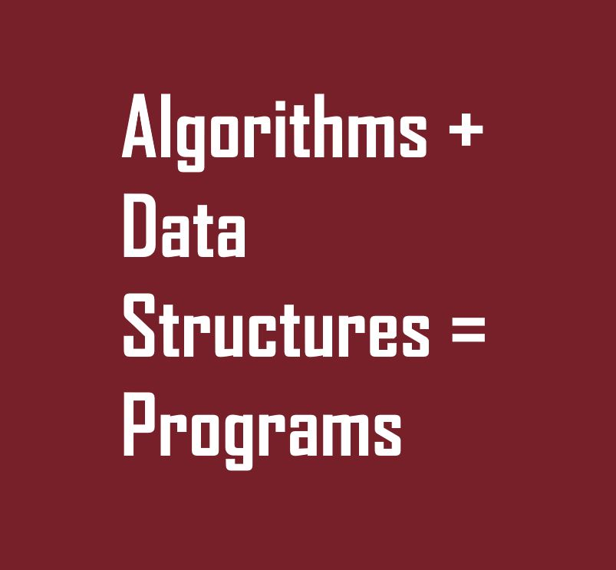

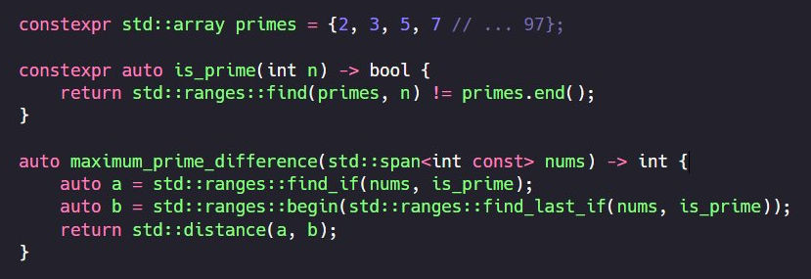

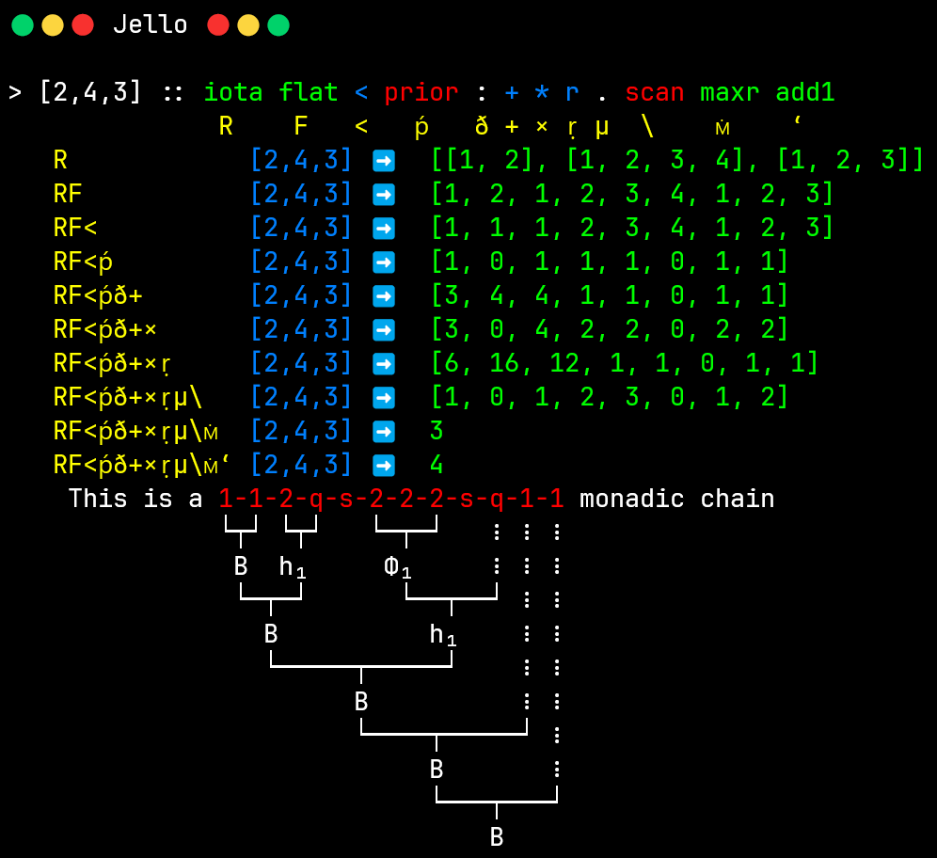
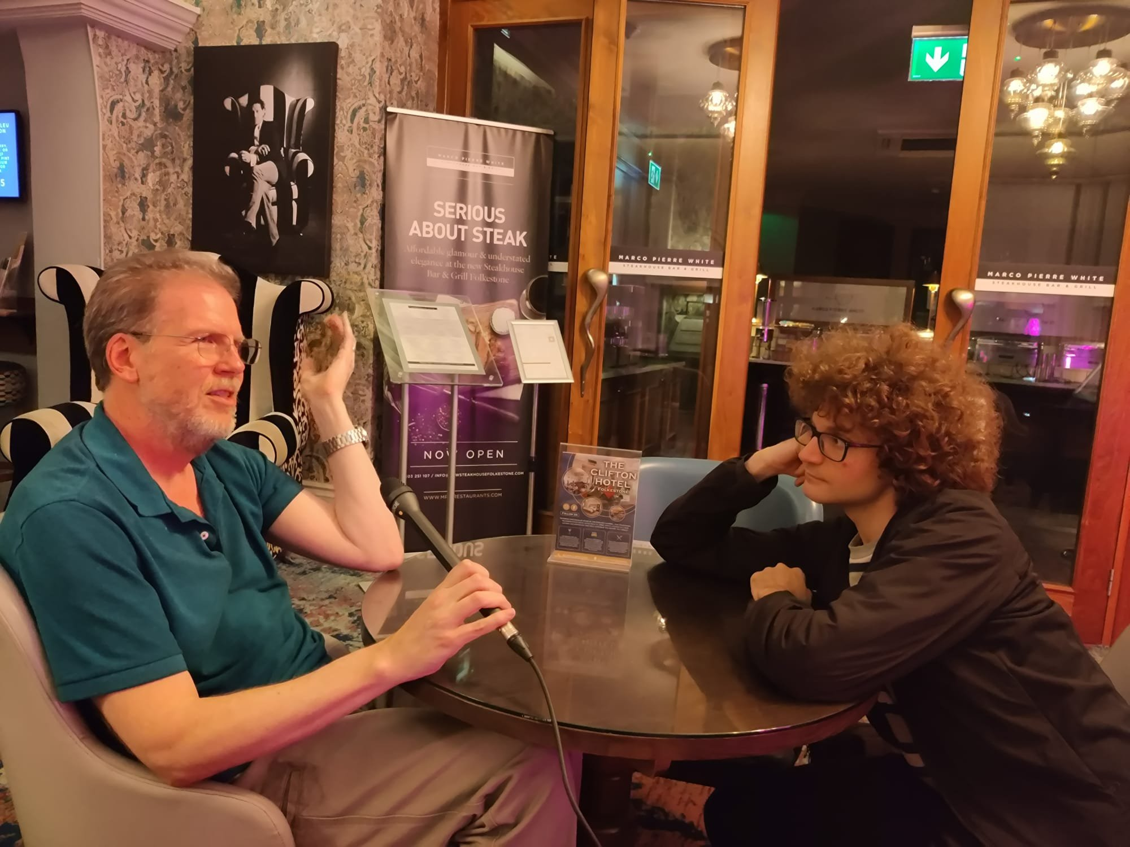
adspthepodcast.com
Notes:
If you're interested in parallel programming, algorithm design, and programming language development, my buddy Conor and I have a podcast – ADSP, Algorithms + Data Structures = Programs, available on all streaming platforms.
Go subscribe now.

Slide 161

The CUDA C++ Developer's Toolbox
GTC CUDA
Developer Track
nvda.ws/4gtfY1r
Accelerated
Computing Hub
nvda.ws/46b2Nik
NVIDIA
DLI Courses
nvda.ws/42DdlEt
ADSP
Podcast
adspthepodcast.com
Notes:
Thank you all of you for your attention!

Slide 162
Display Test
Source Sans Pro Black for headings & labels.
Bold NVIDIA Sans for highlights in text.
DINPro-Black for NVIDIA product names.
NVIDIA Sans underline and italics for compare/contrast in text.
NVIDIA Green with white text
A minimum sized text box
Ty
Ty
Default box
Ty
Ty
Ty
Ty
Ty
Ty
Ty
Ty
Ty
Ty
Ty
Ty
Ty
Ty
Ty
Ty
Source Sans Pro Black | DINPro-Black
NVIDIA Sans | Trebuchet MS
Consolas | Cambria Math
int a, b, c, d, e, f, g, h, i;
int j, k, l, m, n, o, p, q, r;
// … Comment …
nvidia::highlight(o, h + q, [](){});
other::highlight(o, h + q, [](){});
if (unhighlighted(o, h + q, d)) x();

